Slide 1
PRJ3 Scrum Introduction / Recap

Slide 2
Agenda
What is Agile?
What is Scrum?
Why Scrum?
Scrum Framework
Teamwork: Roles in Scrum
Meetings in Scrum
User Stories
Performance

Slide 3
What is Agile?
Time focused
Iterative
Incremental product development
Deliver small pieces
Feedback
Agile Manifesto (12 principles)
Individuals and interactions over processes and tools
Working software over comprehensive documentation
Customer collaboration over contract negotiation
Responding to change over following a plan
Does not mean skip all documentation work!!!
http://agilemanifesto.org/
Agile
Lean
Scrum
XP
Kanban
Notes:
What does it mean if somebody says, he works agile or uses an agile process?
Time focused, usually using Time Boxing: Do not exceed time given for meetings.
Iterative, doing the work in iterations, for instance, doing analysis, design, implementation and testing again and again
Incremental product development means creating small pieces of functionality and thus
Developing these small pieces
The most important thing in agile is the feedback part.
So what all these agile processes have in common is that they follow the 12 principles of the agile manifesto. This manifesto was developed by some guys, e.g. Robert C. Martin (Uncle Bob), Ron Jeffries (Creator of Spring), Alistair Cockburn (Use Case Expert), Martin Fowler, Kent Beck, Ken Schwaber, Jeff Sutherland… asf.

Slide 4

What is Scrum?
Agile Managementframework
Ken Schwaber
Jeff Sutherland
Empirical process
Goal is to produce
Does NOT ensure success
Is hard work
http://www.scrumguides.org/
Notes:
Agile Management Framework following the agile manifesto and their principles to create a product
It is an empirical process, that means that all the time the workflow, tools and processes will be inspected and adapted if needed due to improvement
Goal is to produce

Slide 5
What is Scrum?
Self organized teams
Transparency
Continuous improvement (Inspect and Adapt)
Priorities set by business
Iterative steps (Sprints)
Requirements in backlog
No specific development method recommended
Few but strict rules

Slide 6
Scrum Misunderstandings
Agile/Scrum is NOT:
“Just start to work”
Everybody can do what she/he wants
There are no rules
Nobody needs processes
…

Slide 7
Scrum Project profile
Technology Level
Complexity
Innovation/Novelity
Time Pressure
By Shenhar/Dvir
Notes:
Different project types
Innovation:
Derivative, a derivate of a succesfull product
Platform: a new version of an existing product with much market research needed etc.
Breakthrough product: extremly challending, no real market yet exists. Customers need to experience your product.
Technology Level (technically difficult)
Low-Tech: no rechnology risk as good known tech level
Mid-Tech:
High-Tech: probably unclear requirements for a long time etc.
Complexity
Assembly: Building straight-forward product
System: Building ships, cars building or complex software programs.
Array: multiple systems, many stakeholders, high risk.
Time pressure
Regular
Fast/Competitive
Time-Critical
Blitz

Slide 8
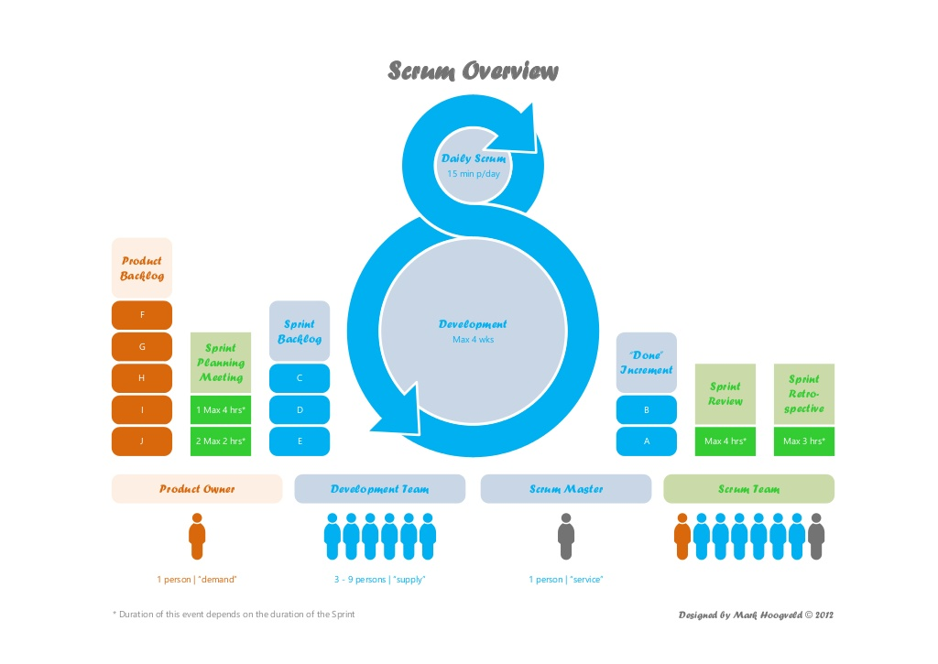
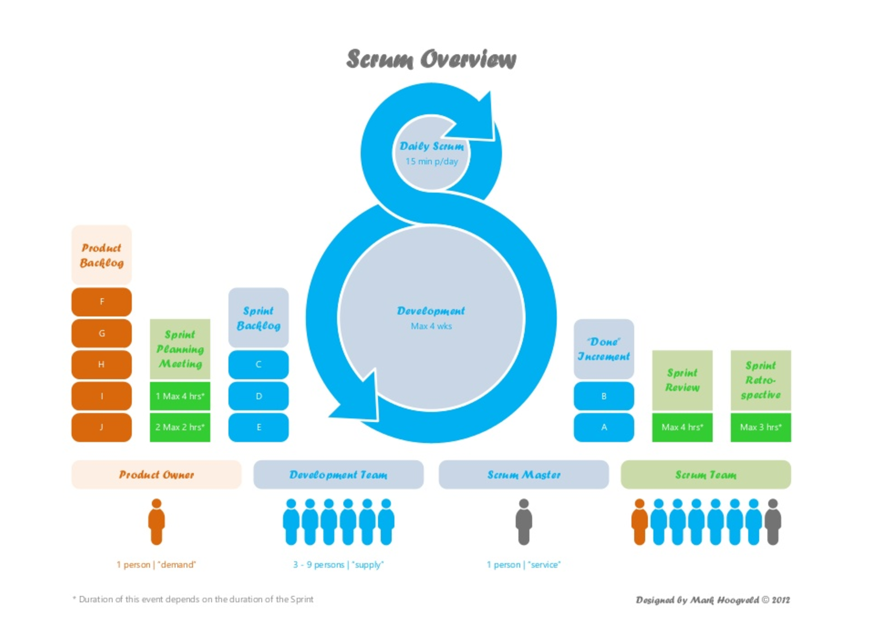
The Roles
Notes:
Planning: 1w / 2h, 2w / 4h… max 8h
Review: 1h for 1 week sprint → 1w / 1h, 2w, 2h… max 4h
Retrospective: 45m for 1 week sprint → 1w / 45m, 2w / 1,5h... Max 3h

Slide 9
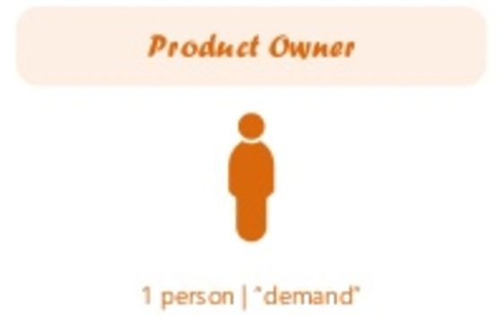
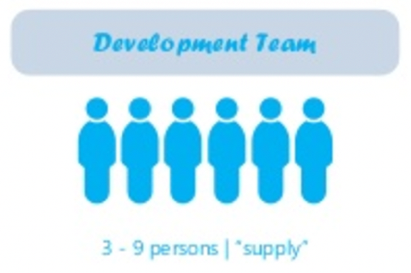
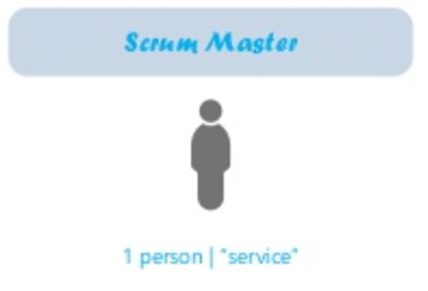
Scrum Roles
Product Backlog
Business Value
Contact person for team
Estimations
Delivers releasable increments
Interdisciplinary
Self organizing
Ensures process
Helps removing impediments
Moderation
Coaching

Slide 10
The Roles
Notes:
Planning: 1w / 2h, 2w / 4h… max 8h
Review: 1h for 1 week sprint → 1w / 1h, 2w, 2h… max 4h
Retrospective: 45m for 1 week sprint → 1w / 45m, 2w / 1,5h... Max 3h

Slide 11
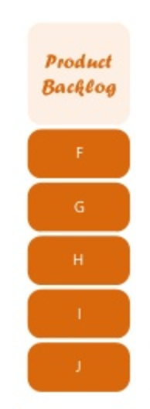
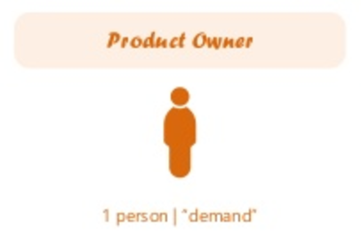
Product backlog / Product Owner
Product Owner is responsible for maximizing the value of the product and the work of the Development team
Responsible for managing Product Backlog
Product Backlog is a list of everything which might be needed for the product (Backlog Items)
Product Backlog is the single source of requirements
PO puts new Backlog Items into PB
Order of PB in PO defines “importance” and thus steers which one to do next
Notes:
Examples:
Can be very coarses grained like: User Administration or Secure Server Connection
Can be very precise: As an administrator I want to have a user account blocked on fraud detection, so that this user is not able to use the services anymore. Testcase: When a new user is created AND the user triggers a fraud scenario THEN this user must be blocked in the backend and is not able to login again.

Slide 12
Product Backlog Items as User Stories
Short and simple description of features from the perspective of the user
As an Administrator, I want to check and confirm a new blog entry so that it is visible on my webpage.
Or
An Administrator can check and confirm a new blog entry.

Slide 13
Product Backlog Items as User Stories
User Stories should follow the INVEST acronym
Independent
Negotiable
Valuable
Estimatable
Small
Testable
User Stories should contain Acceptance Criterias

Slide 14
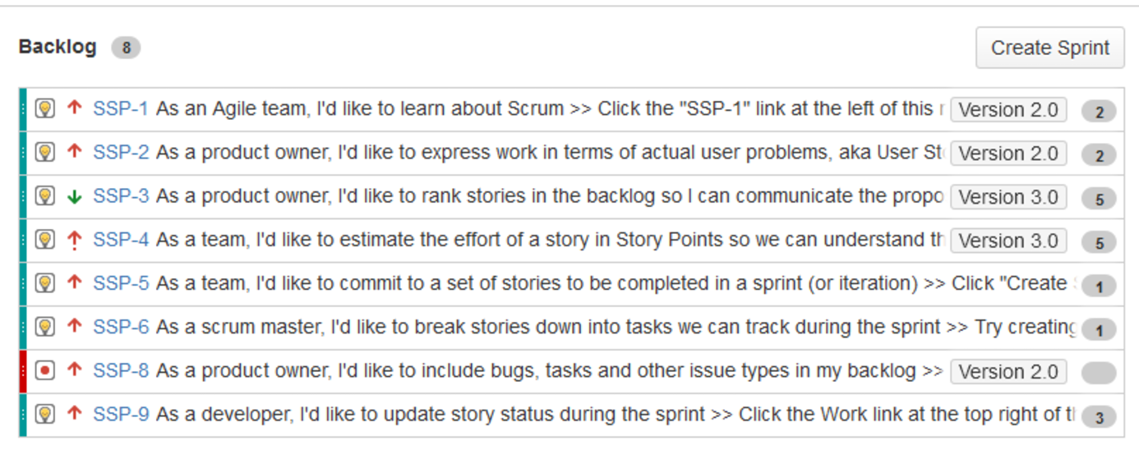
Product Backlog examples
todo

Slide 15
The Roles
Notes:
Planning: 1w / 2h, 2w / 4h… max 8h
Review: 1h for 1 week sprint → 1w / 1h, 2w, 2h… max 4h
Retrospective: 45m for 1 week sprint → 1w / 45m, 2w / 1,5h... Max 3h

Slide 16

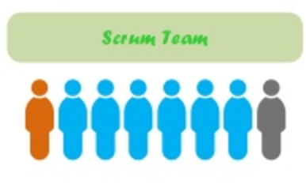

Sprint Planning Meeting
Participants:
Scrum Master
Product Owner
Develoment Team
Timeboxed: Length roughly 2h per 1week sprint
Scrum Master teaches how to stay in timebox
Goals: Which work to complete in the next sprint and how?
Team decides based on capacity and velocity how much work can be done until end of next sprint
Outcome: Sprint Goal and Sprint Backlog

Slide 17
Estimation
Estimate relatively e.g.
Story Points or T-Shirt Sizes
How? Playing Planning Poker
Fibonacci
0
1
2
3
5
8
13
20
40
?
XS
S
M
L
XL
XXL
?

Slide 18
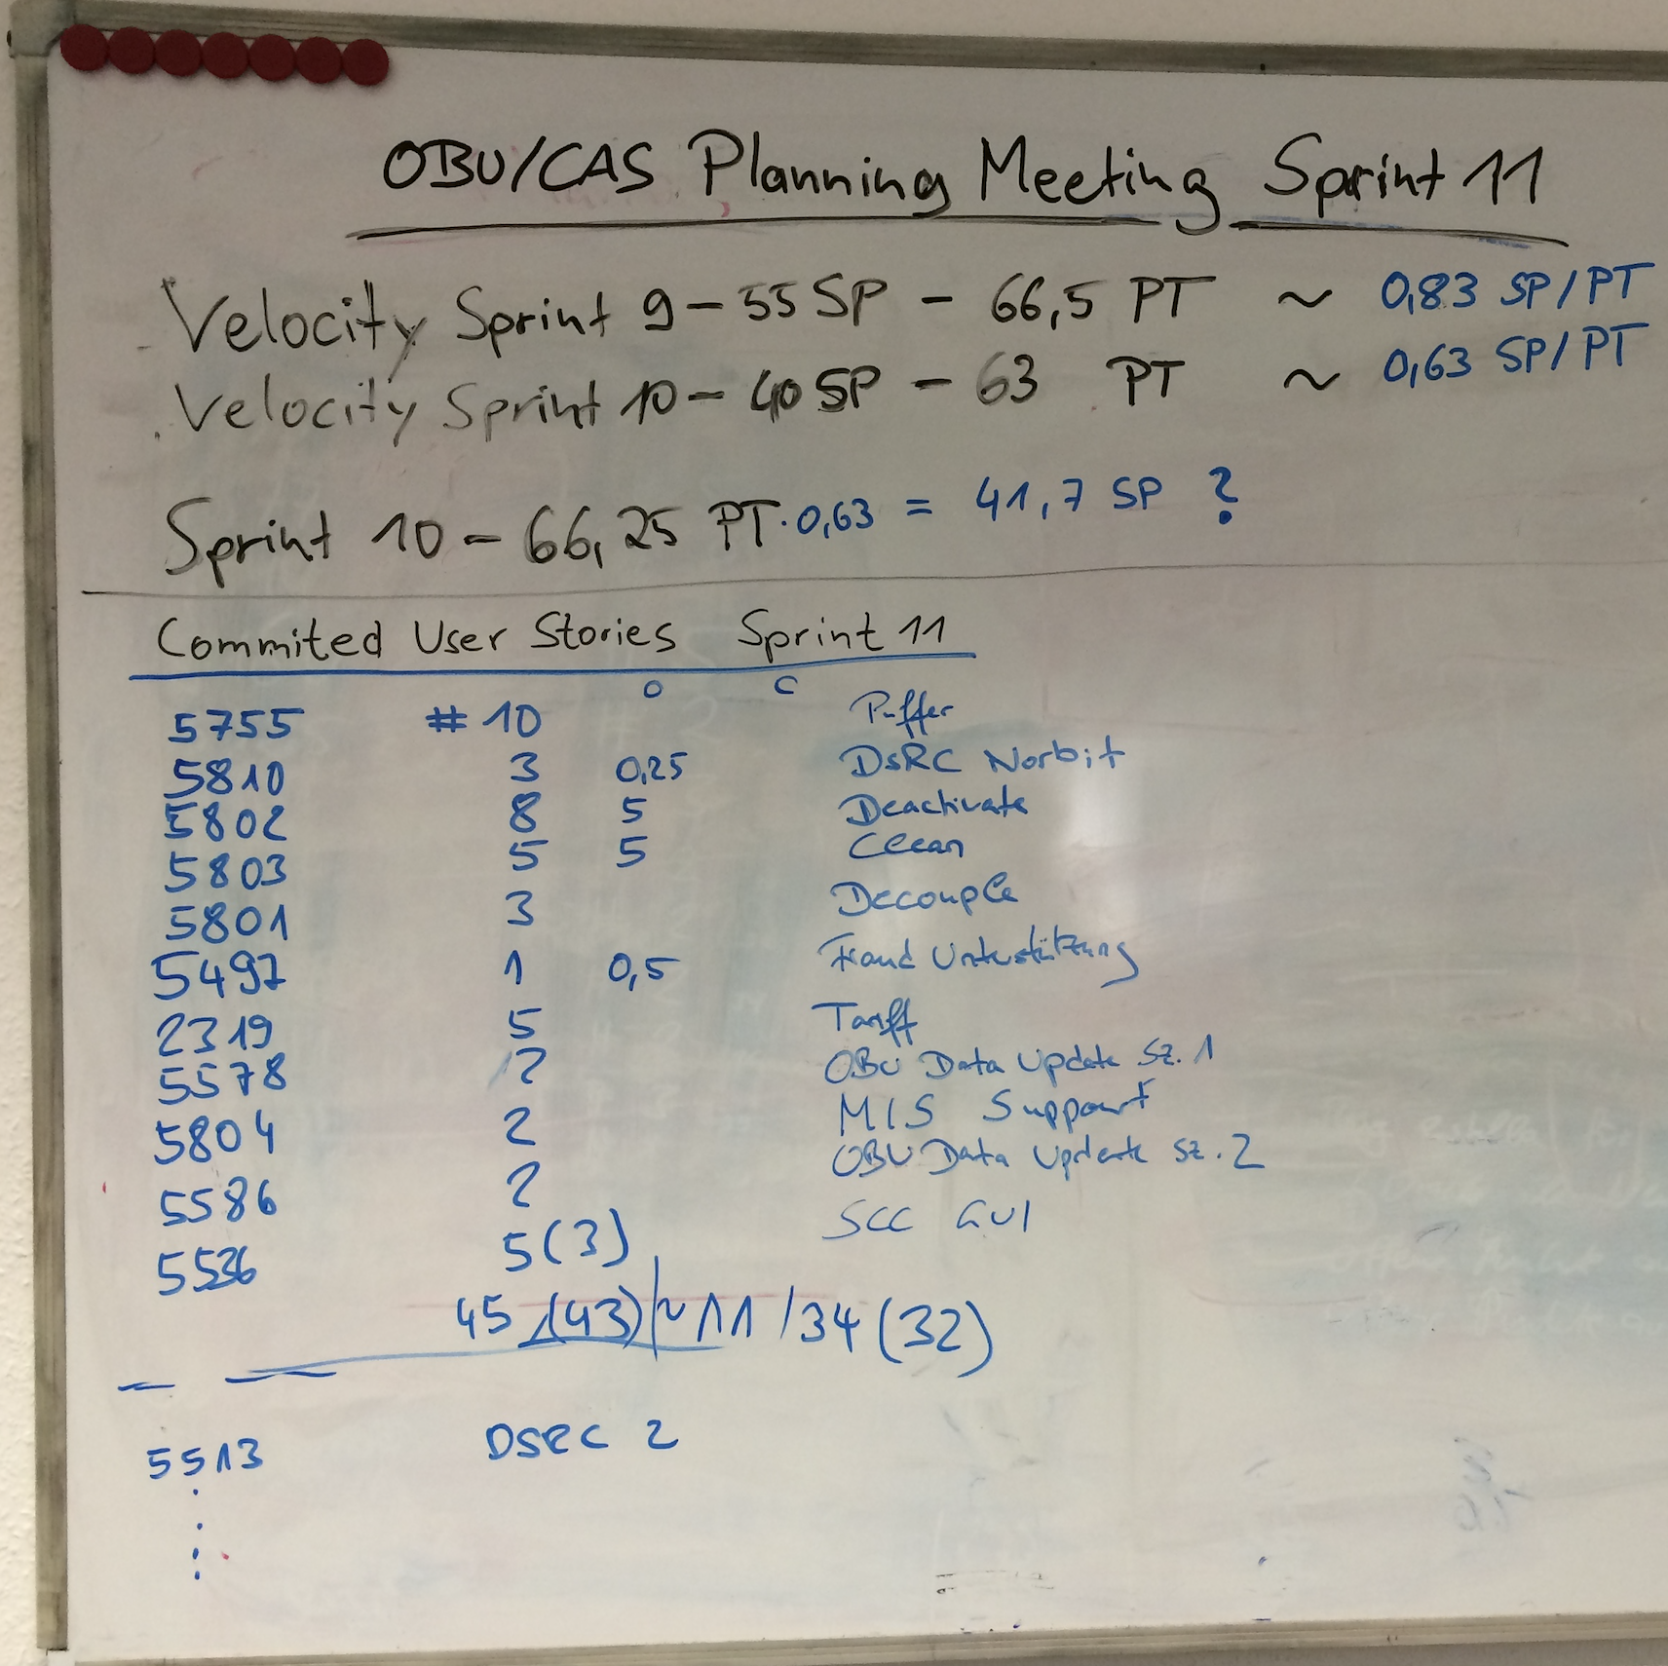
Sprint Planning examples

Slide 19
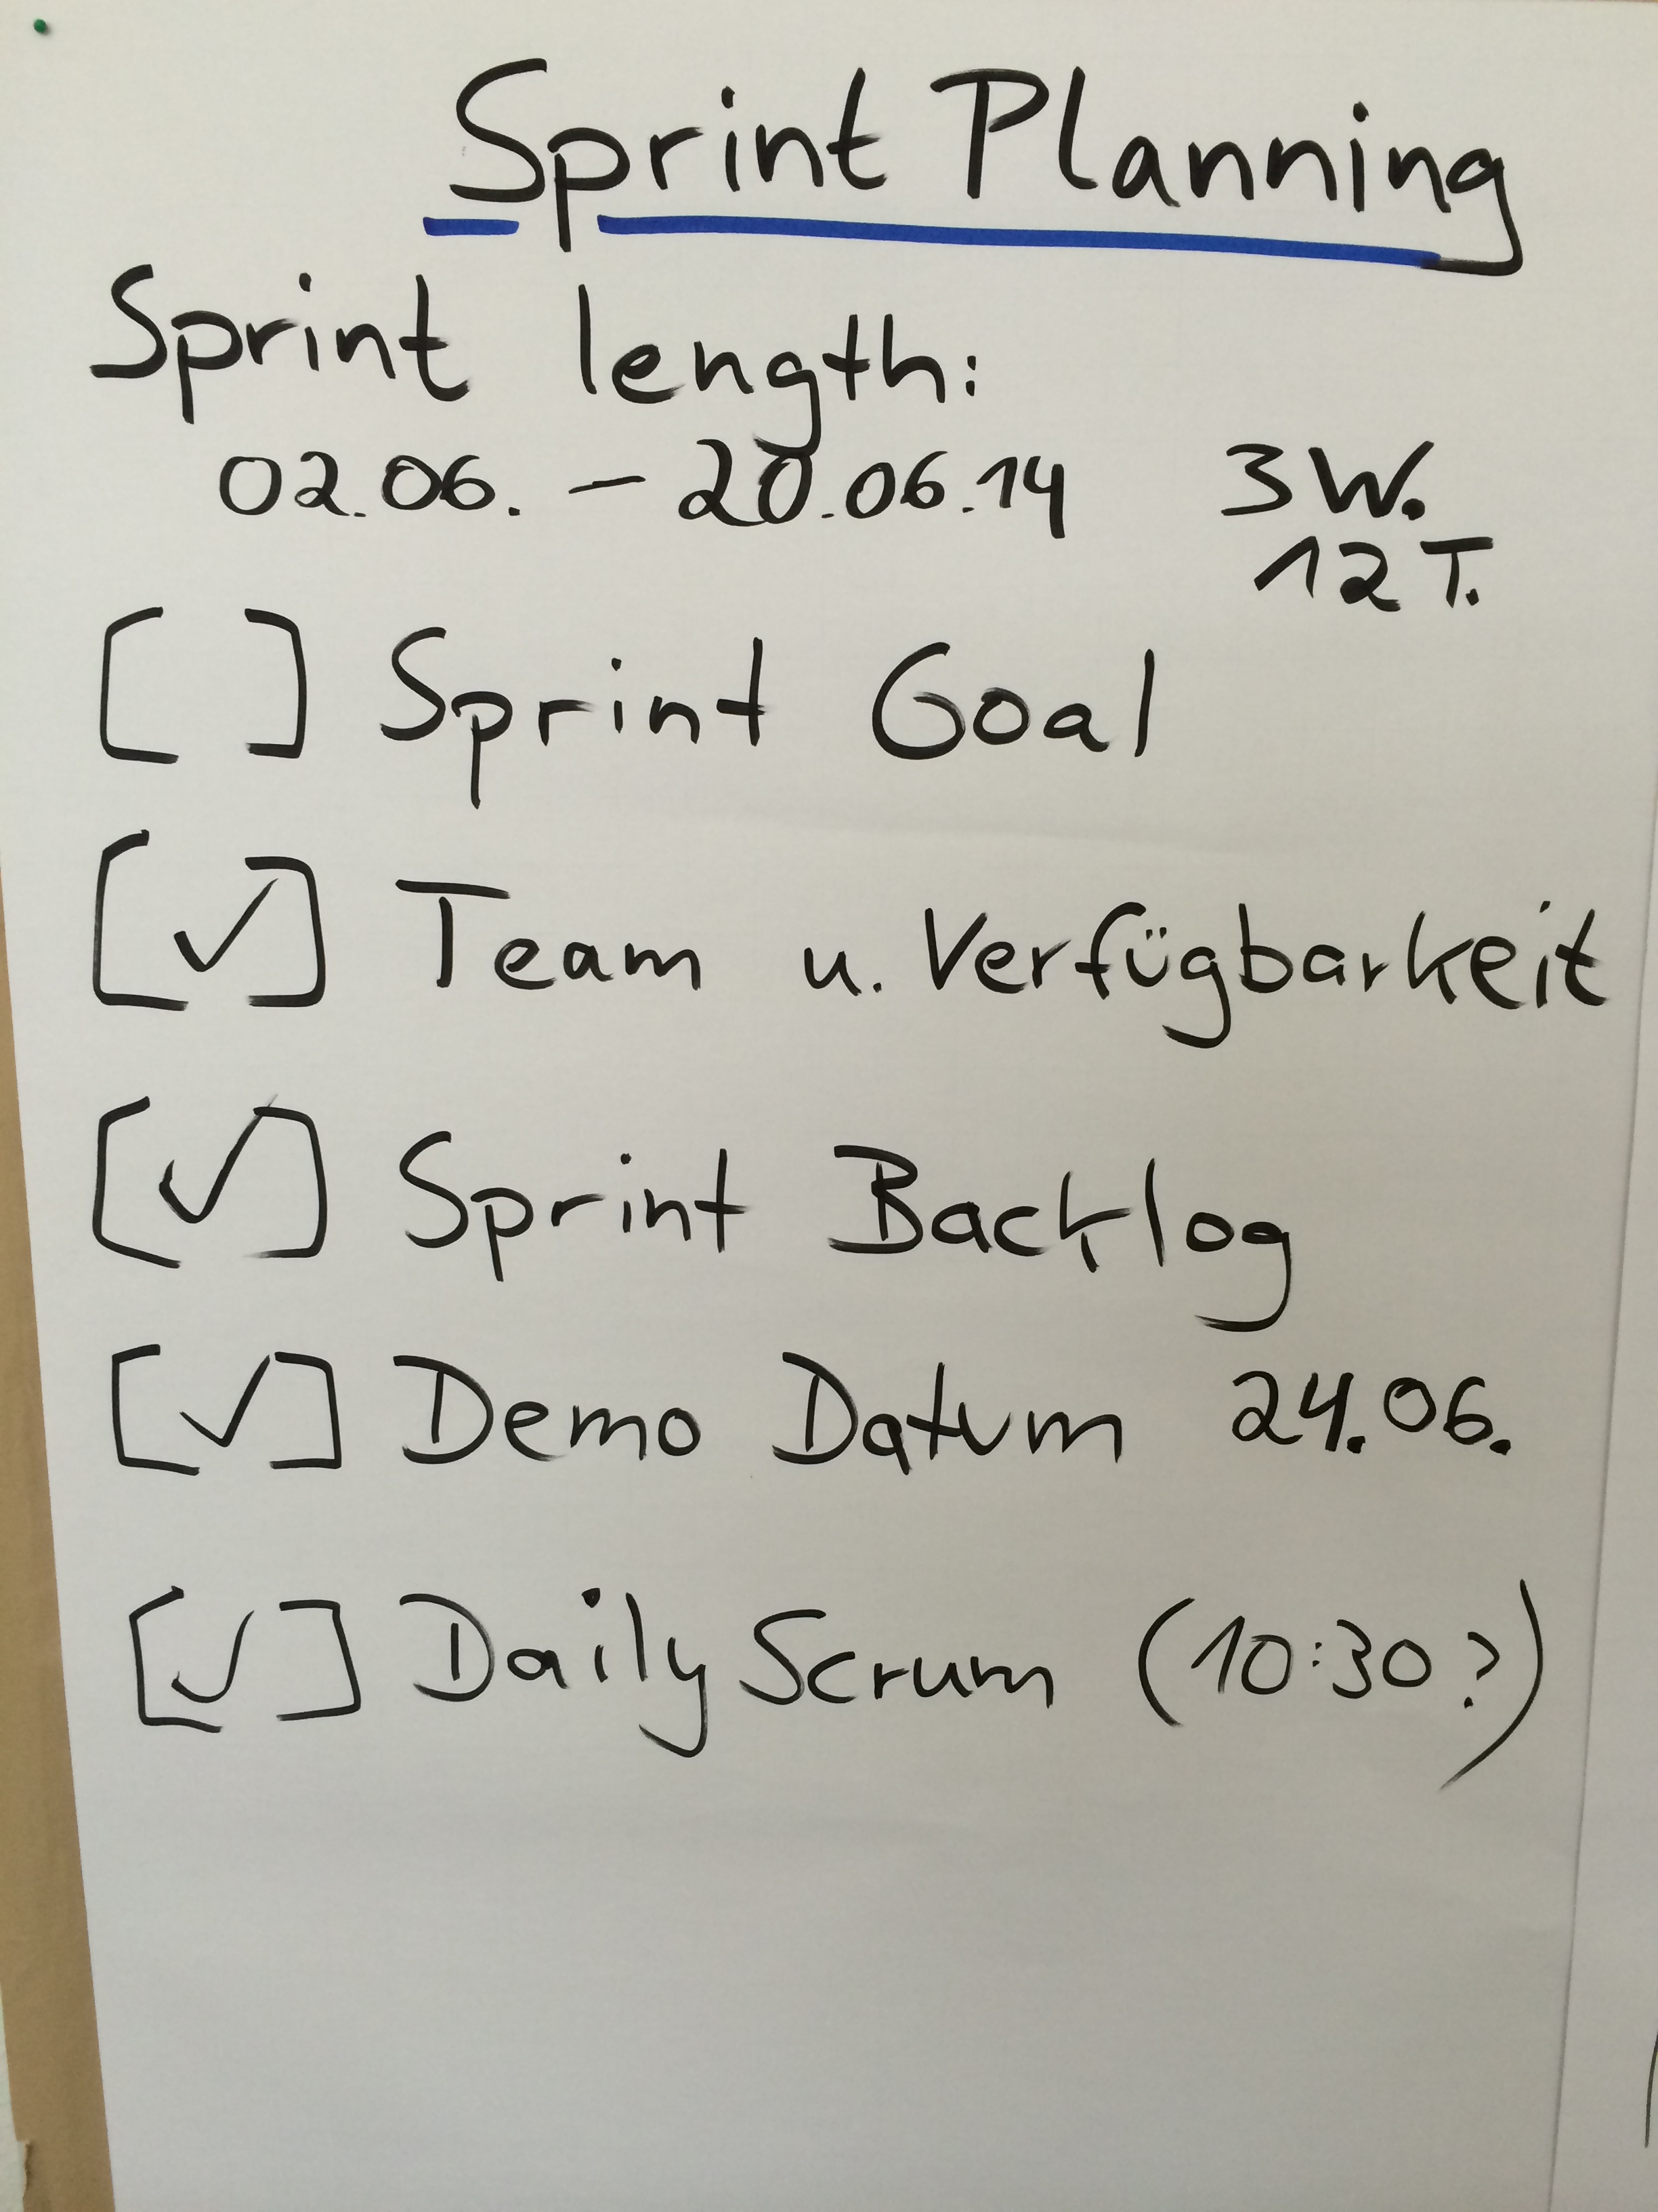
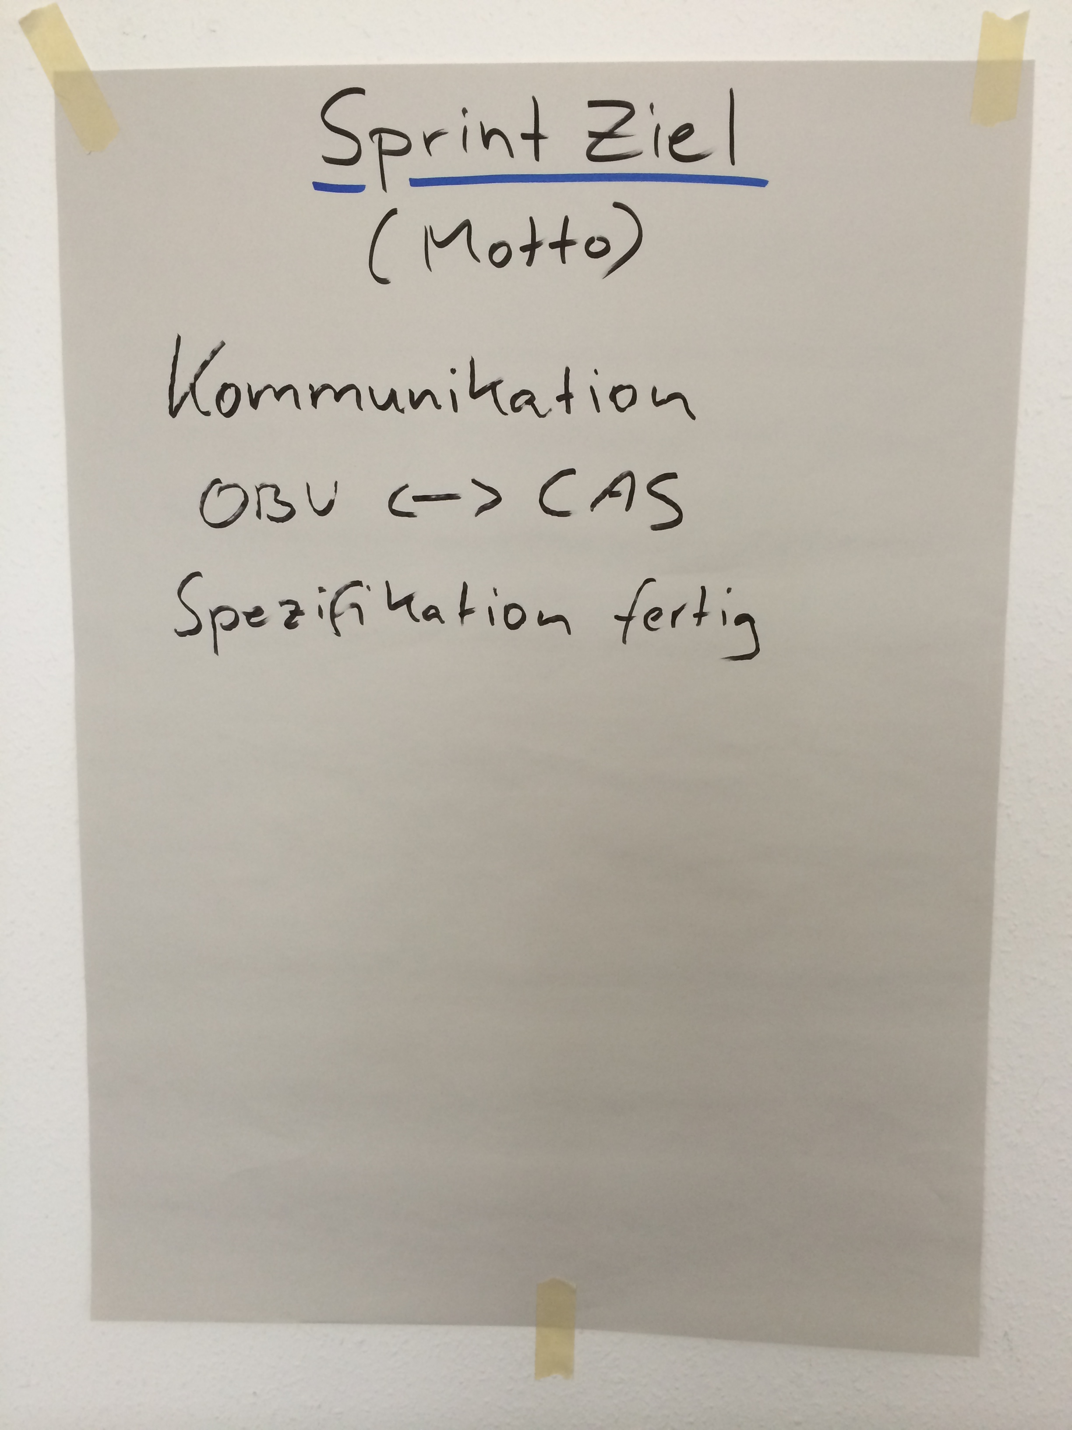
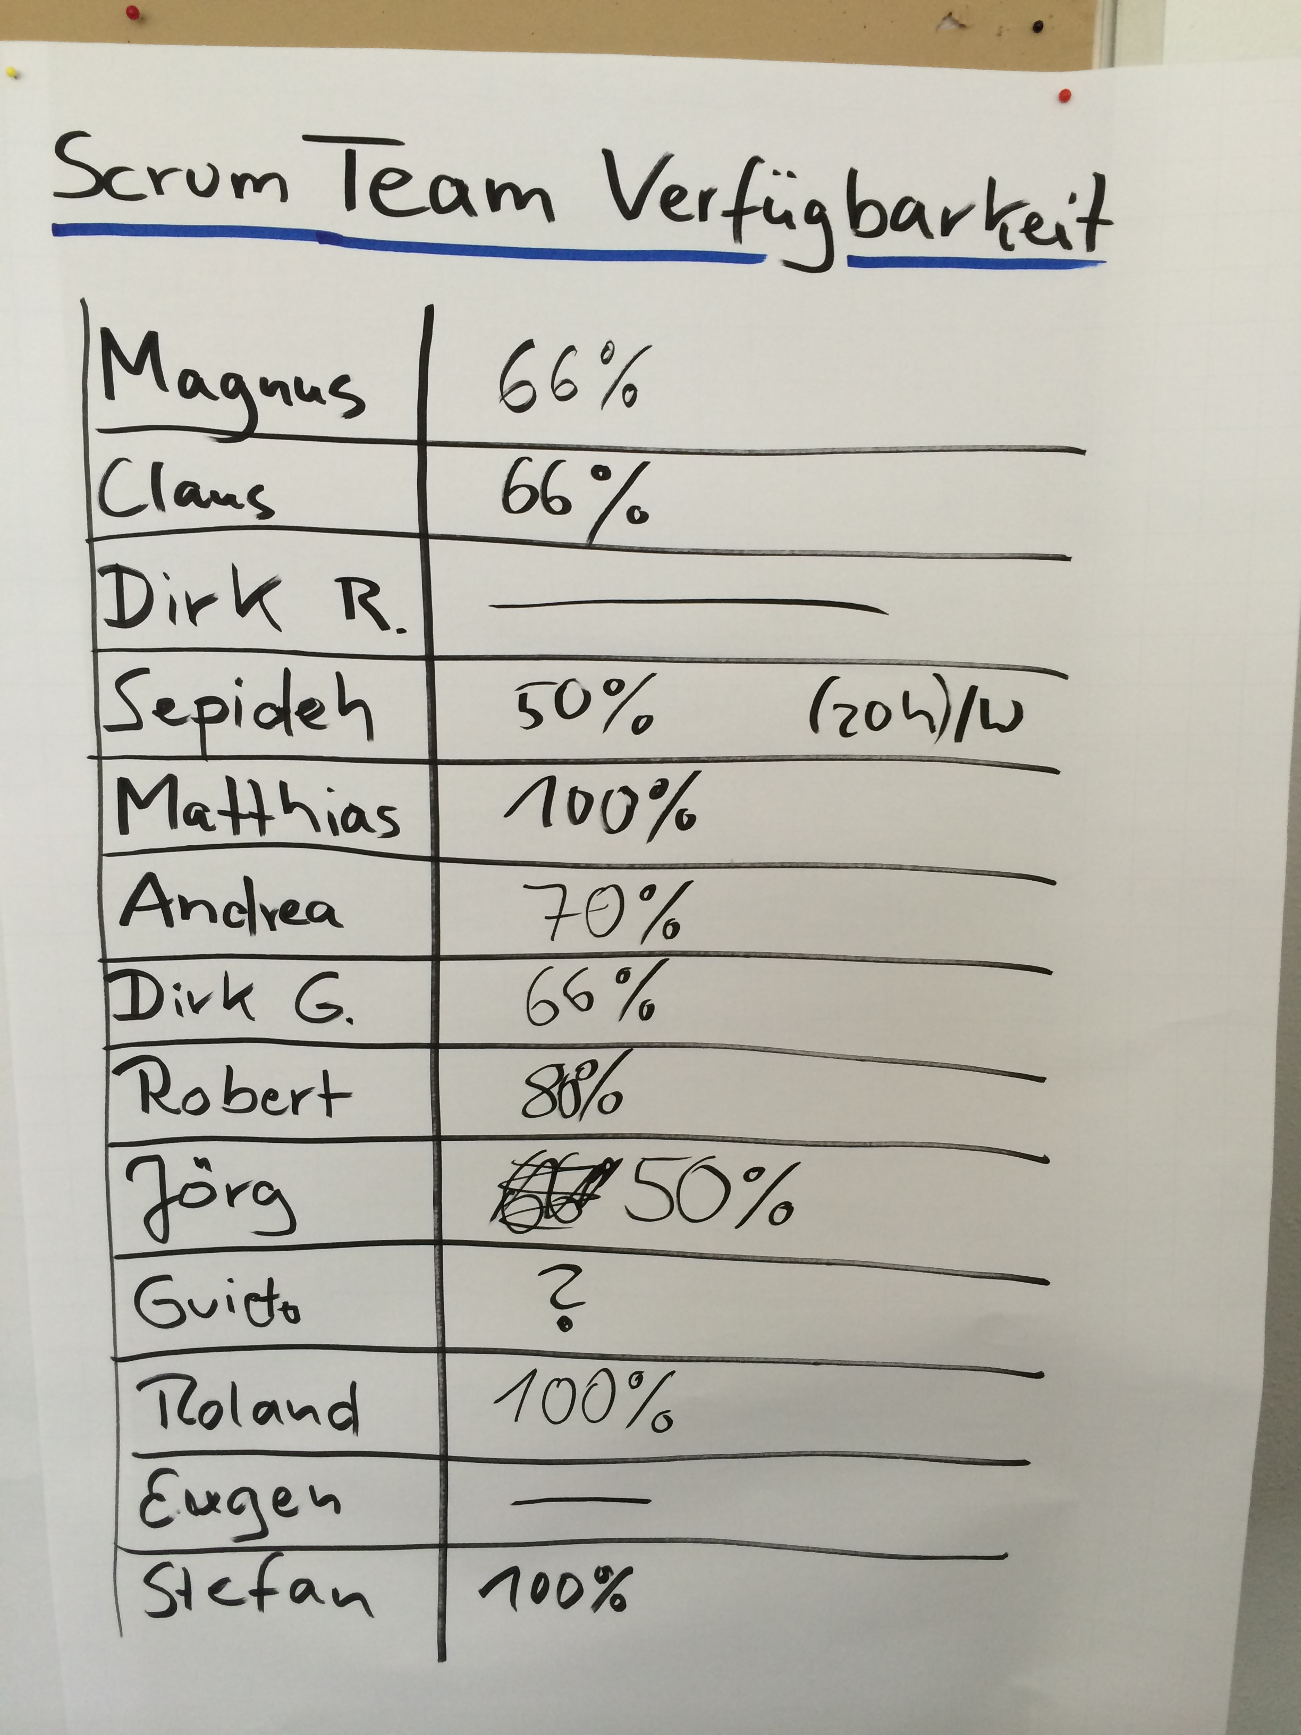
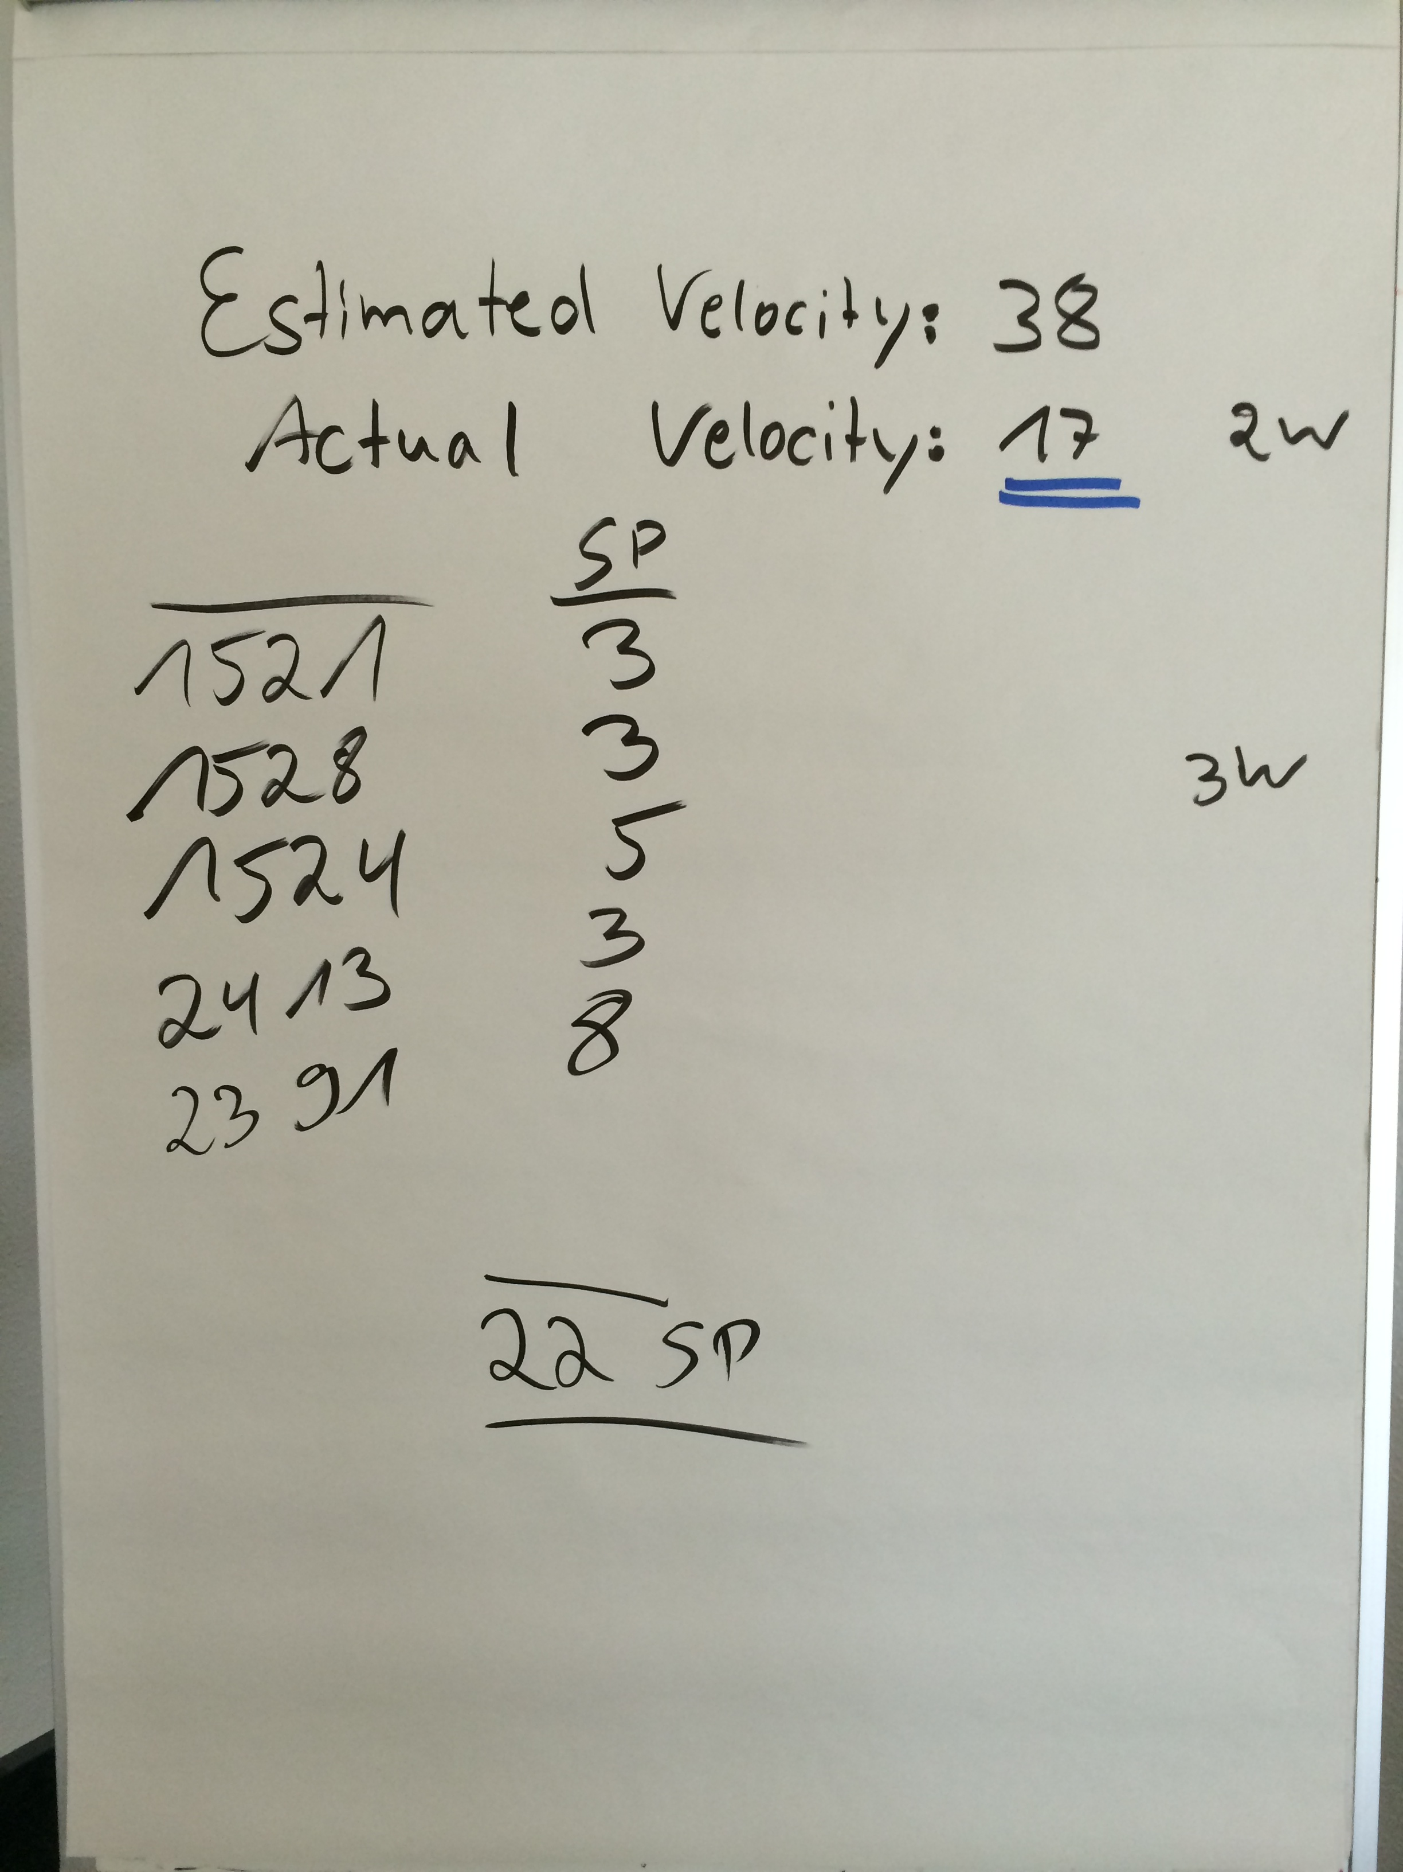
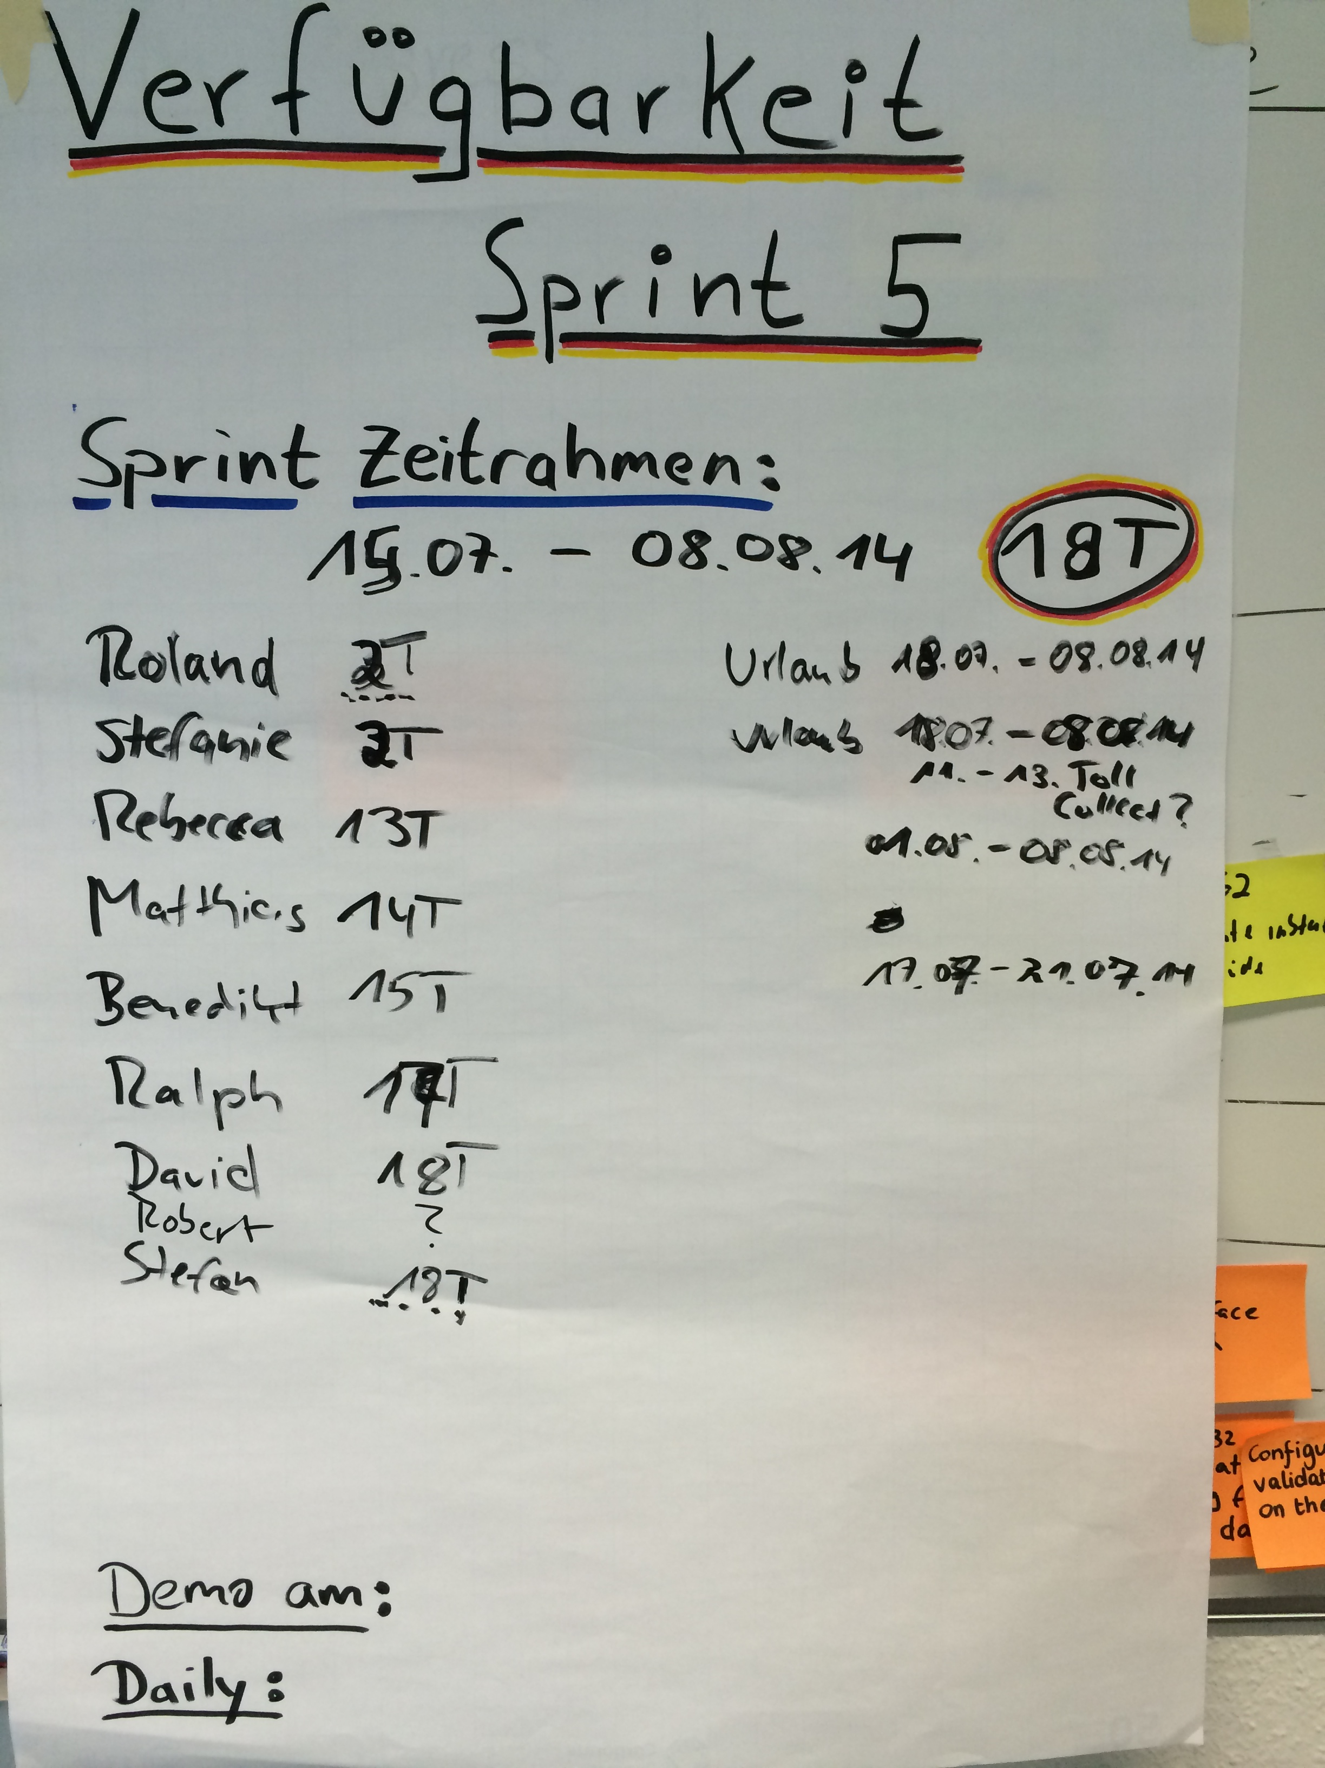

Slide 20
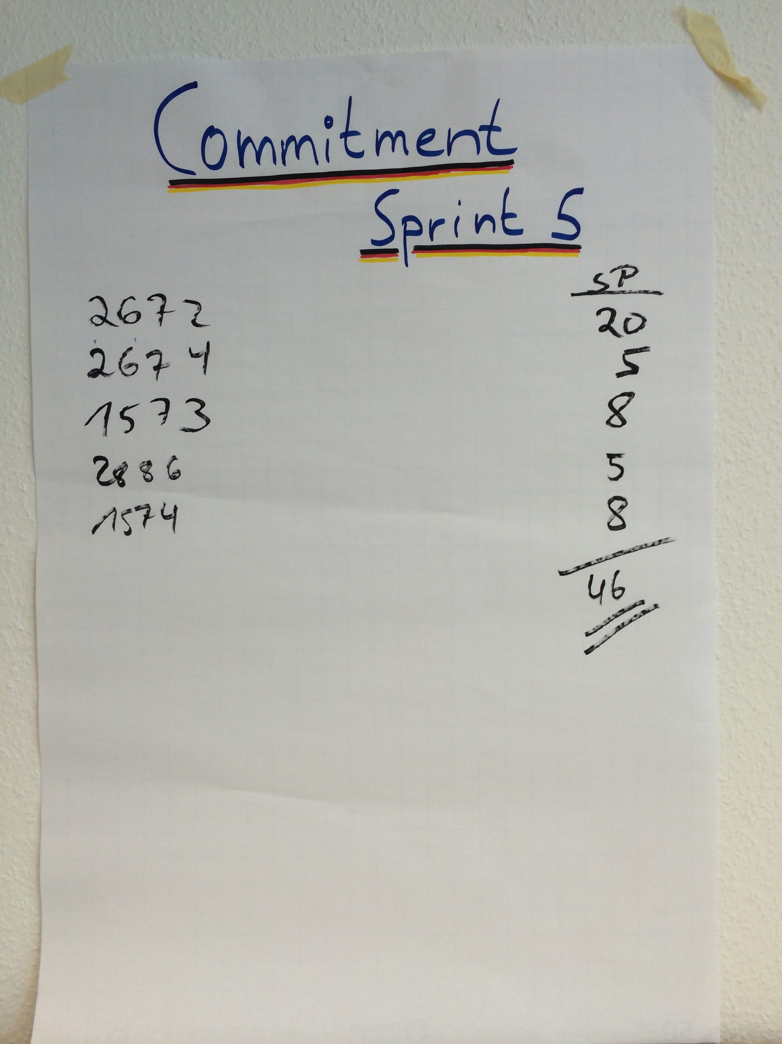

Slide 21
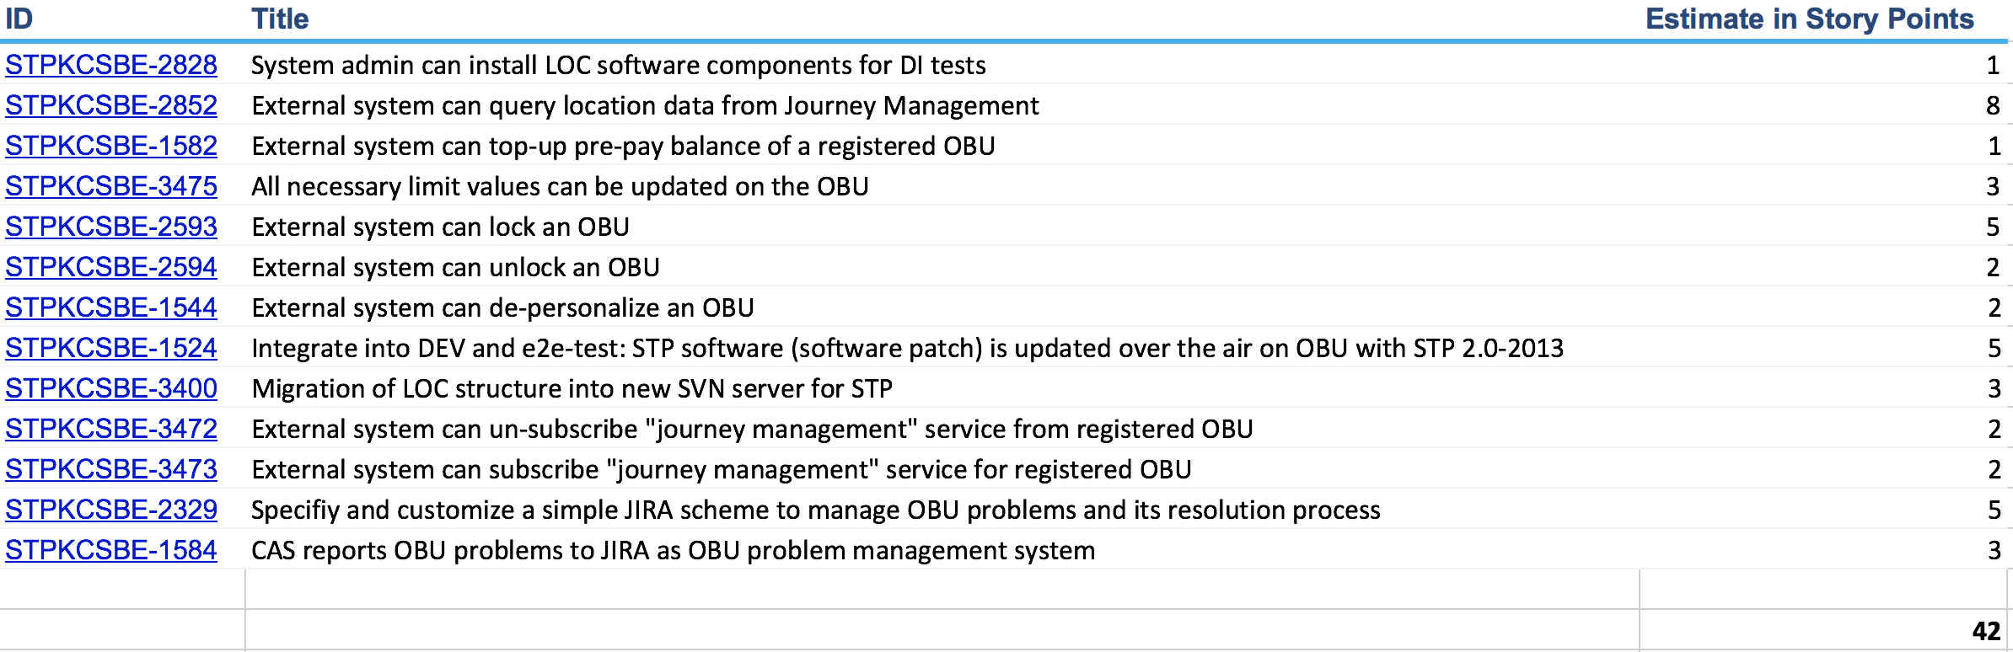
Sprint Backlog Examples

Slide 22
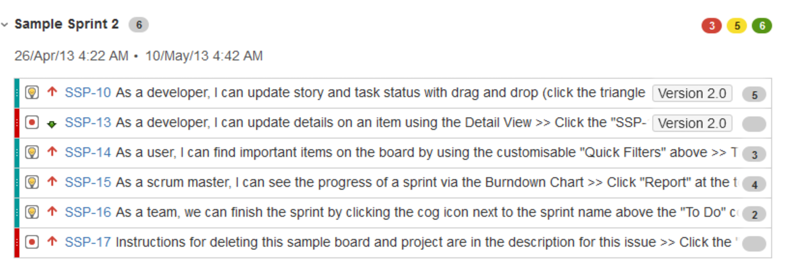
Sprint Backlog Examples
TODO Jira
Notes:
14 SP

Slide 23
The Meetings
Notes:
Planning: 1w / 2h, 2w / 4h… max 8h
Review: 1h for 1 week sprint → 1w / 1h, 2w, 2h… max 4h
Retrospective: 45m for 1 week sprint → 1w / 45m, 2w / 1,5h... Max 3h

Slide 24
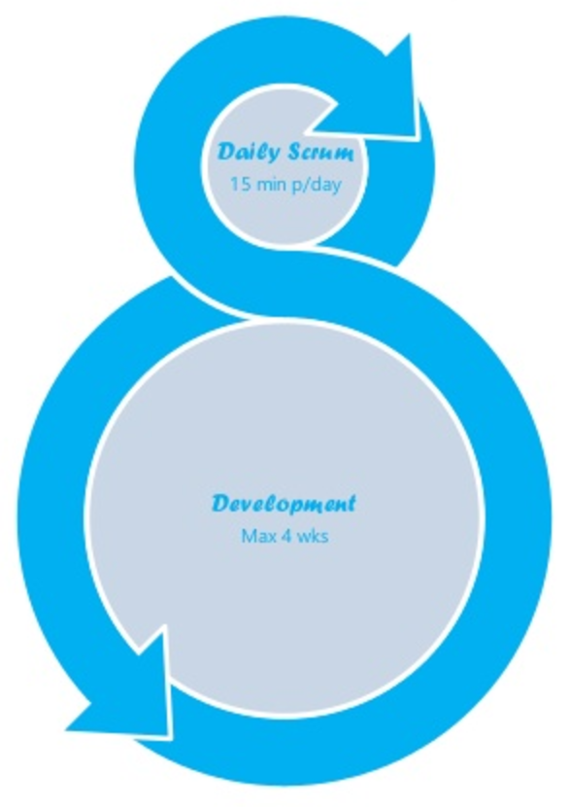
Sprint and Daily Meetings
Team doing the work in the Sprint
Daily is NO Management reporting meeting!!!
Daily Meetings (15 min Timebox)
What did I do/finish yesterday
What will I do/finish today
Issues? (Impediments)
No detailed discussions in daily
Getting the team informed about the progress
Team usually discusses after the meeting

Slide 25
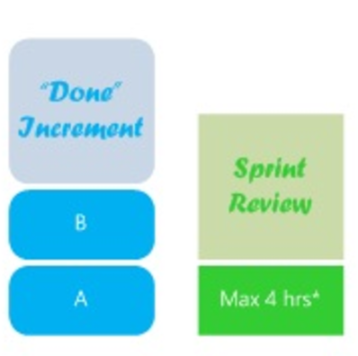
Sprint Review Meeting
Time boxed meeting (1h per 1week)
Participants usually Development Team, Product Owner, Scrum Master and key stakeholder
Team demonstrates the results (Done User Stories)
Product Owner accepts or not accepts User Stories
Probably new Product Backlog Items occur

Slide 26
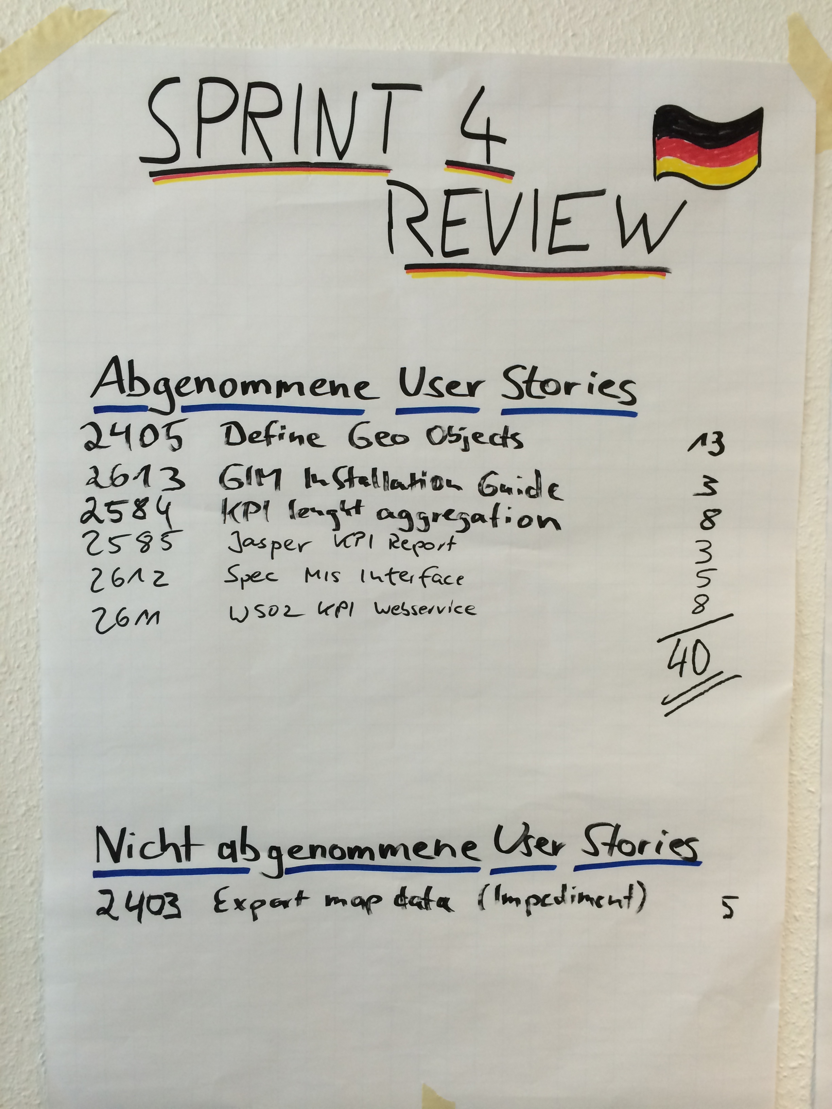
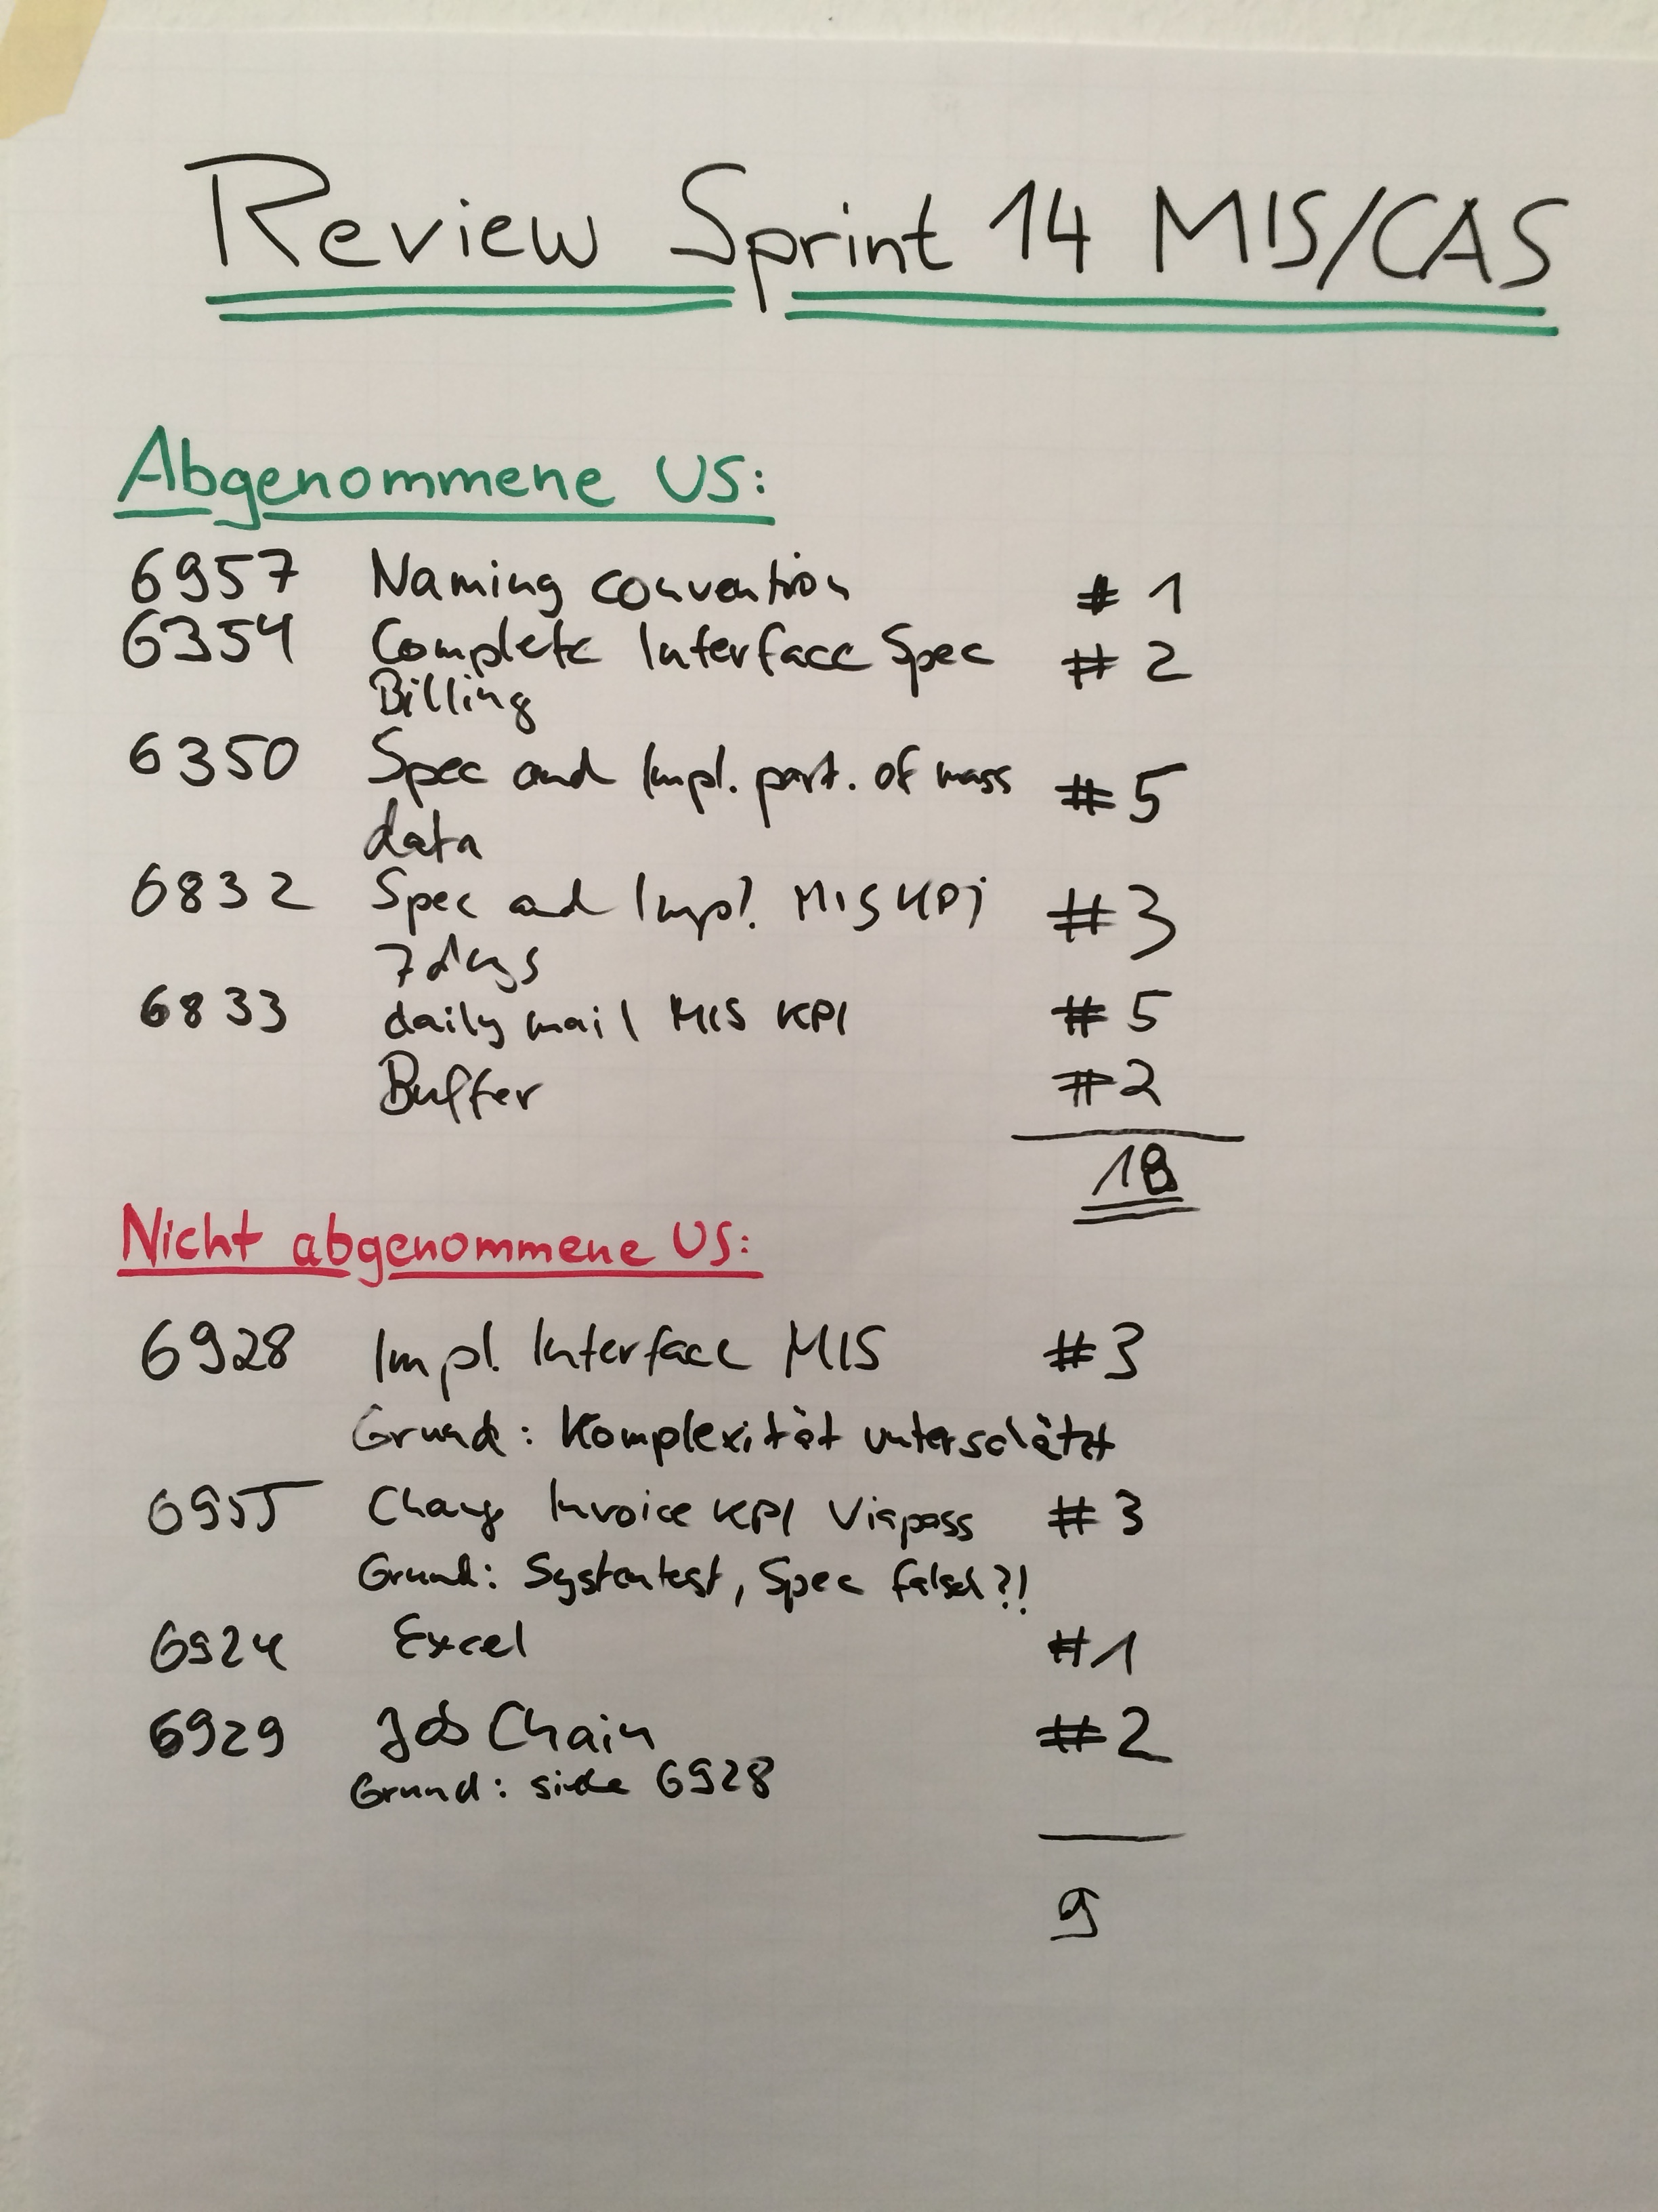
Sprint Review Examples

Slide 27
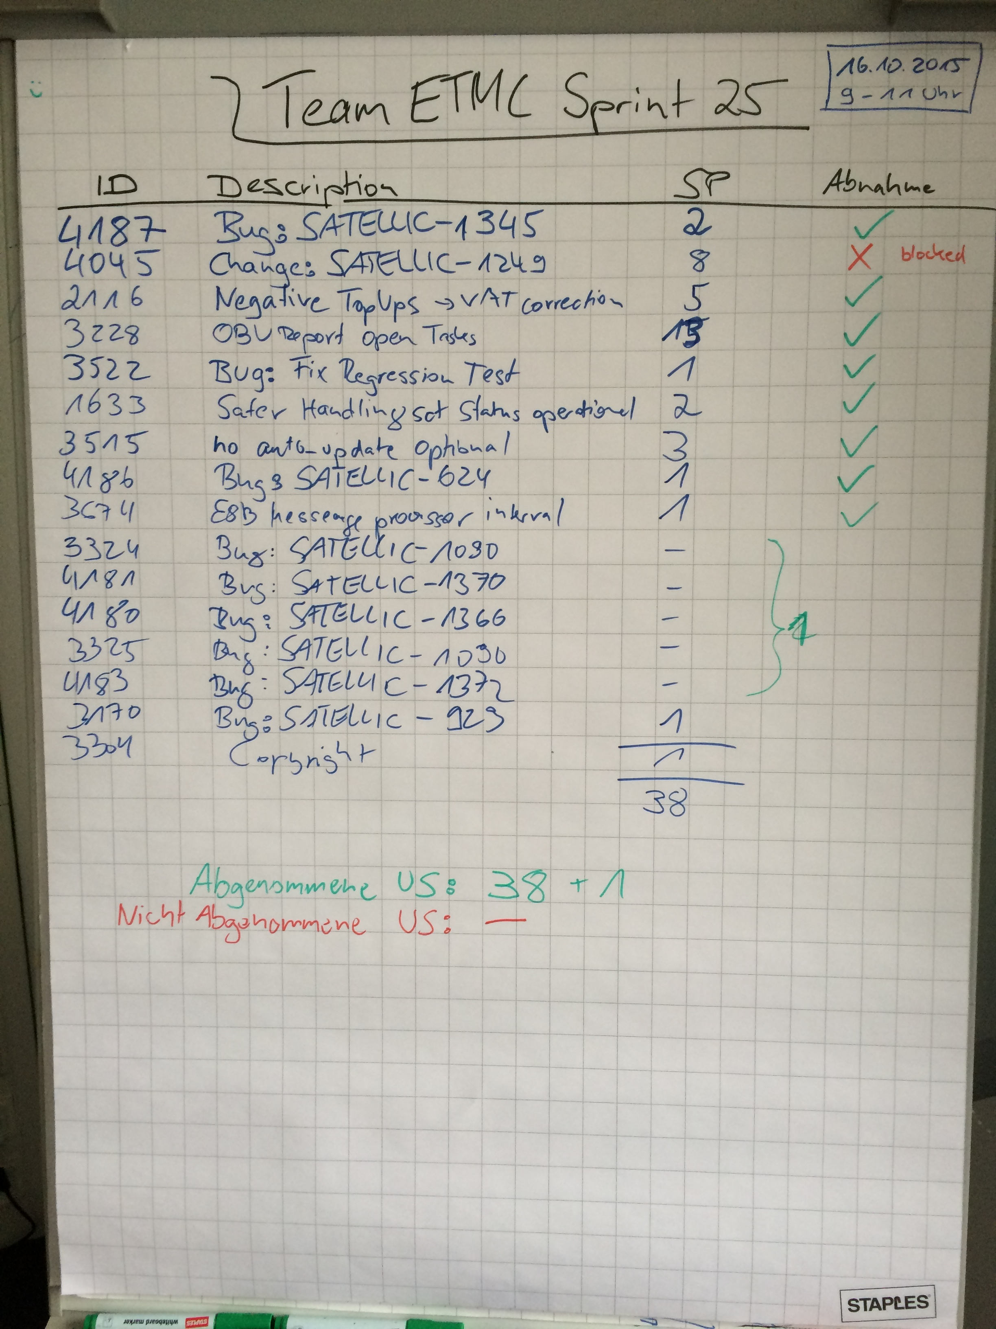
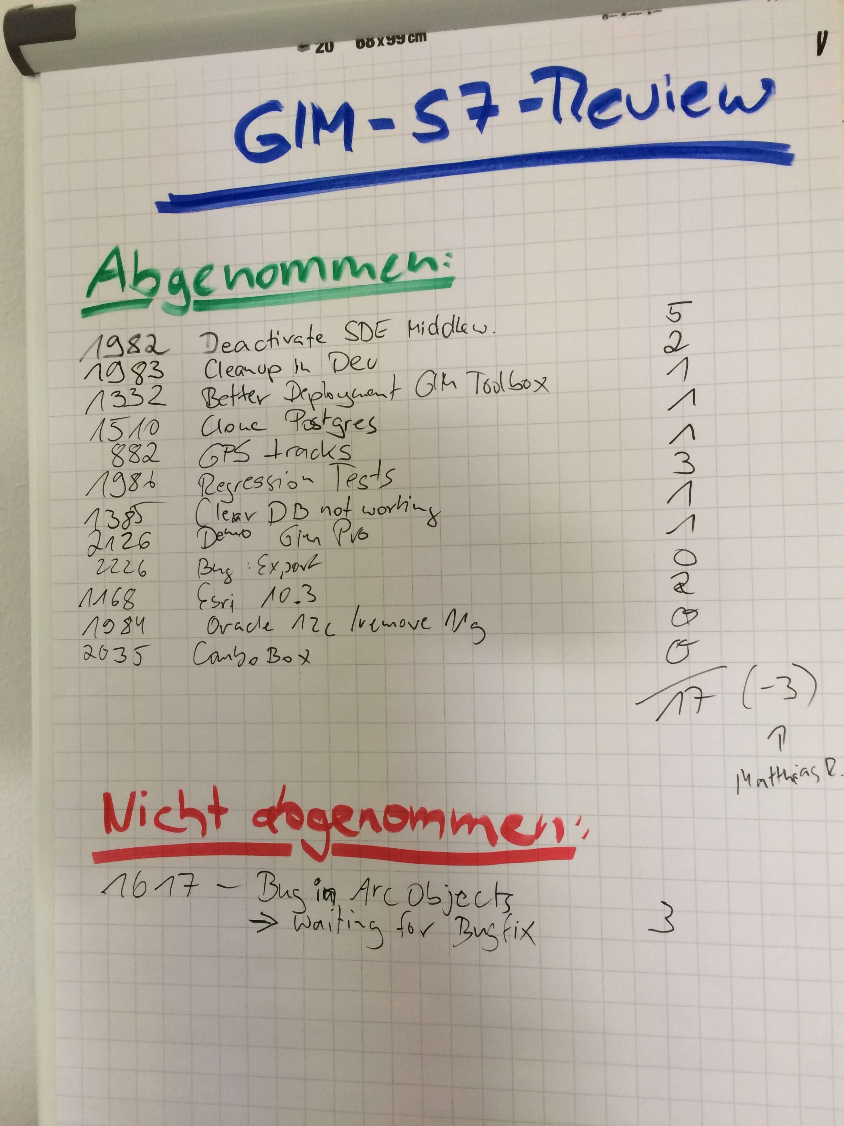

Slide 28
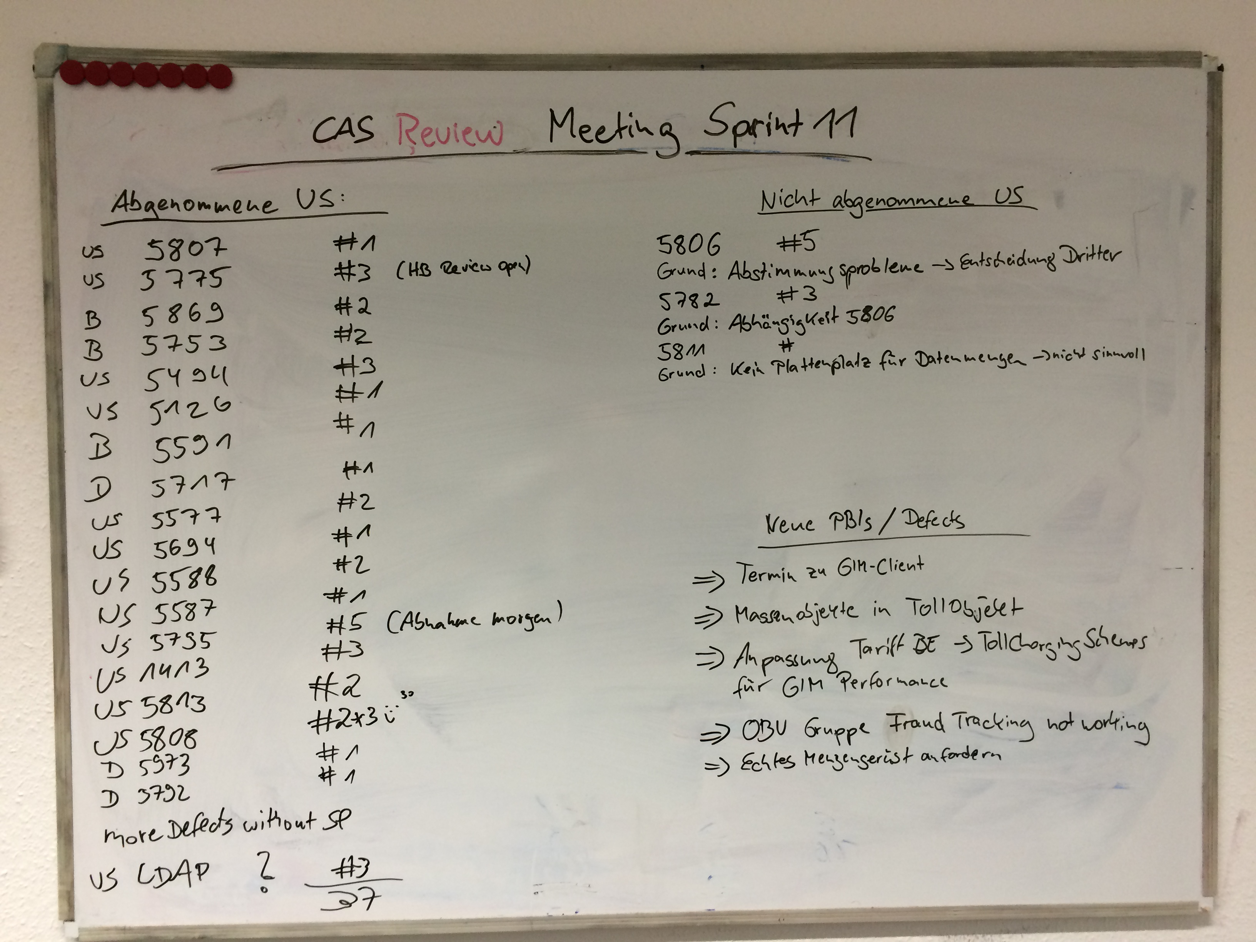

Slide 29
Definition of Done
What means a User Story thus a feature is done?
First of all a User Story is functionally done if the Product Owner is “happy” Acceptance Criteria
What about the quality?

Slide 30
Definition of Done
Scrum does not allow negotiation according to quality.
Set up a Definition of Done for IT e.g.:
Code must be Unit tested. Tests GREEN
Code must be checked in into Version Control System
Successful Automated build, all tests GREEN
Code and/or Spec-Review successfully done (or Pair programming)
Code Coverage >= 85%
Installation manual created/updated (if applicable)
Administration manual created/updated (if applicable)
Acceptance test done (Demo for Product Owner) without errors
Demo done on Integration Environment (not on DEV-machine)
...

Slide 31
The Meetings
Notes:
Planning: 1w / 2h, 2w / 4h… max 8h
Review: 1h for 1 week sprint → 1w / 1h, 2w, 2h… max 4h
Retrospective: 45m for 1 week sprint → 1w / 45m, 2w / 1,5h... Max 3h

Slide 32

Sprint Retrospective
Most important Meeting
What went wrong / what went well regarding process / work / people / tools
Inspect and Adapt
Plan improvements (actions)
Scrum Master moderates

Slide 33
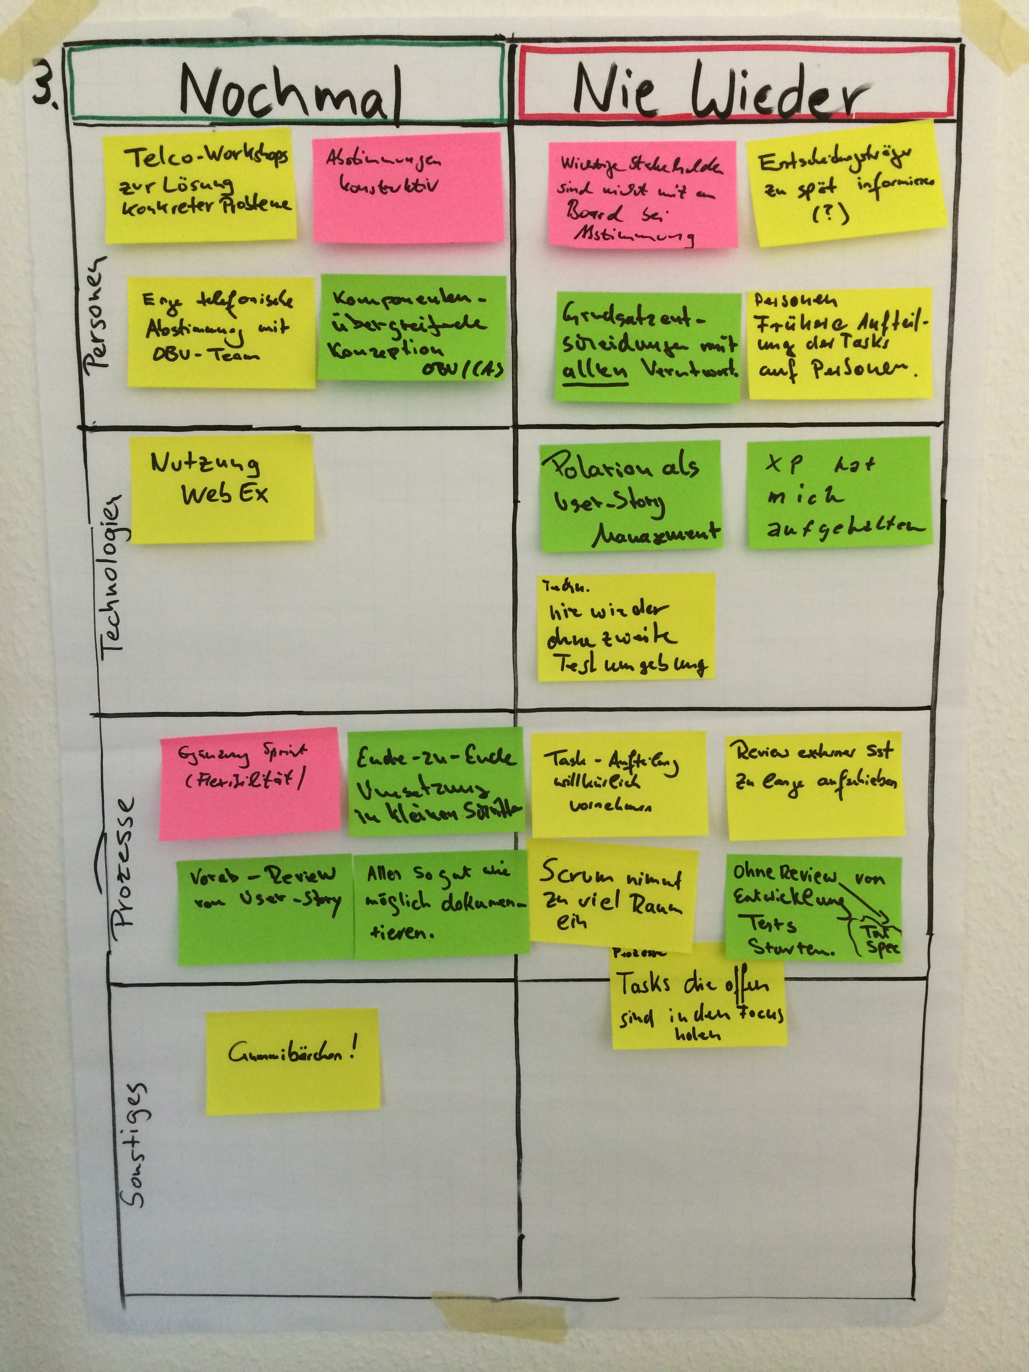
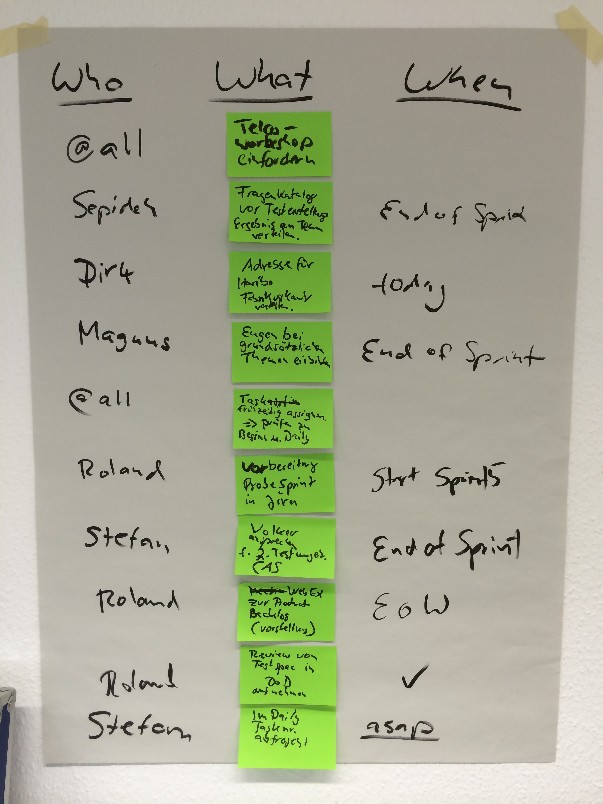

Slide 34
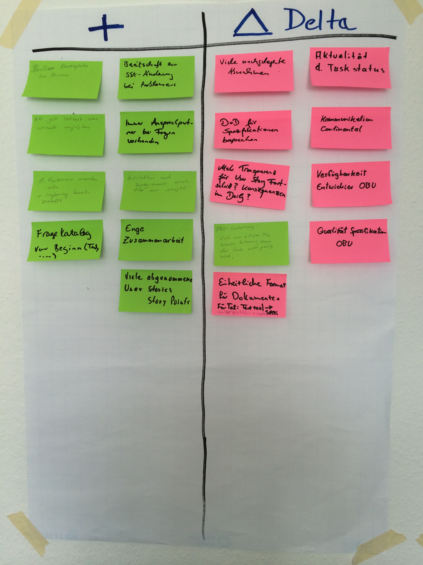
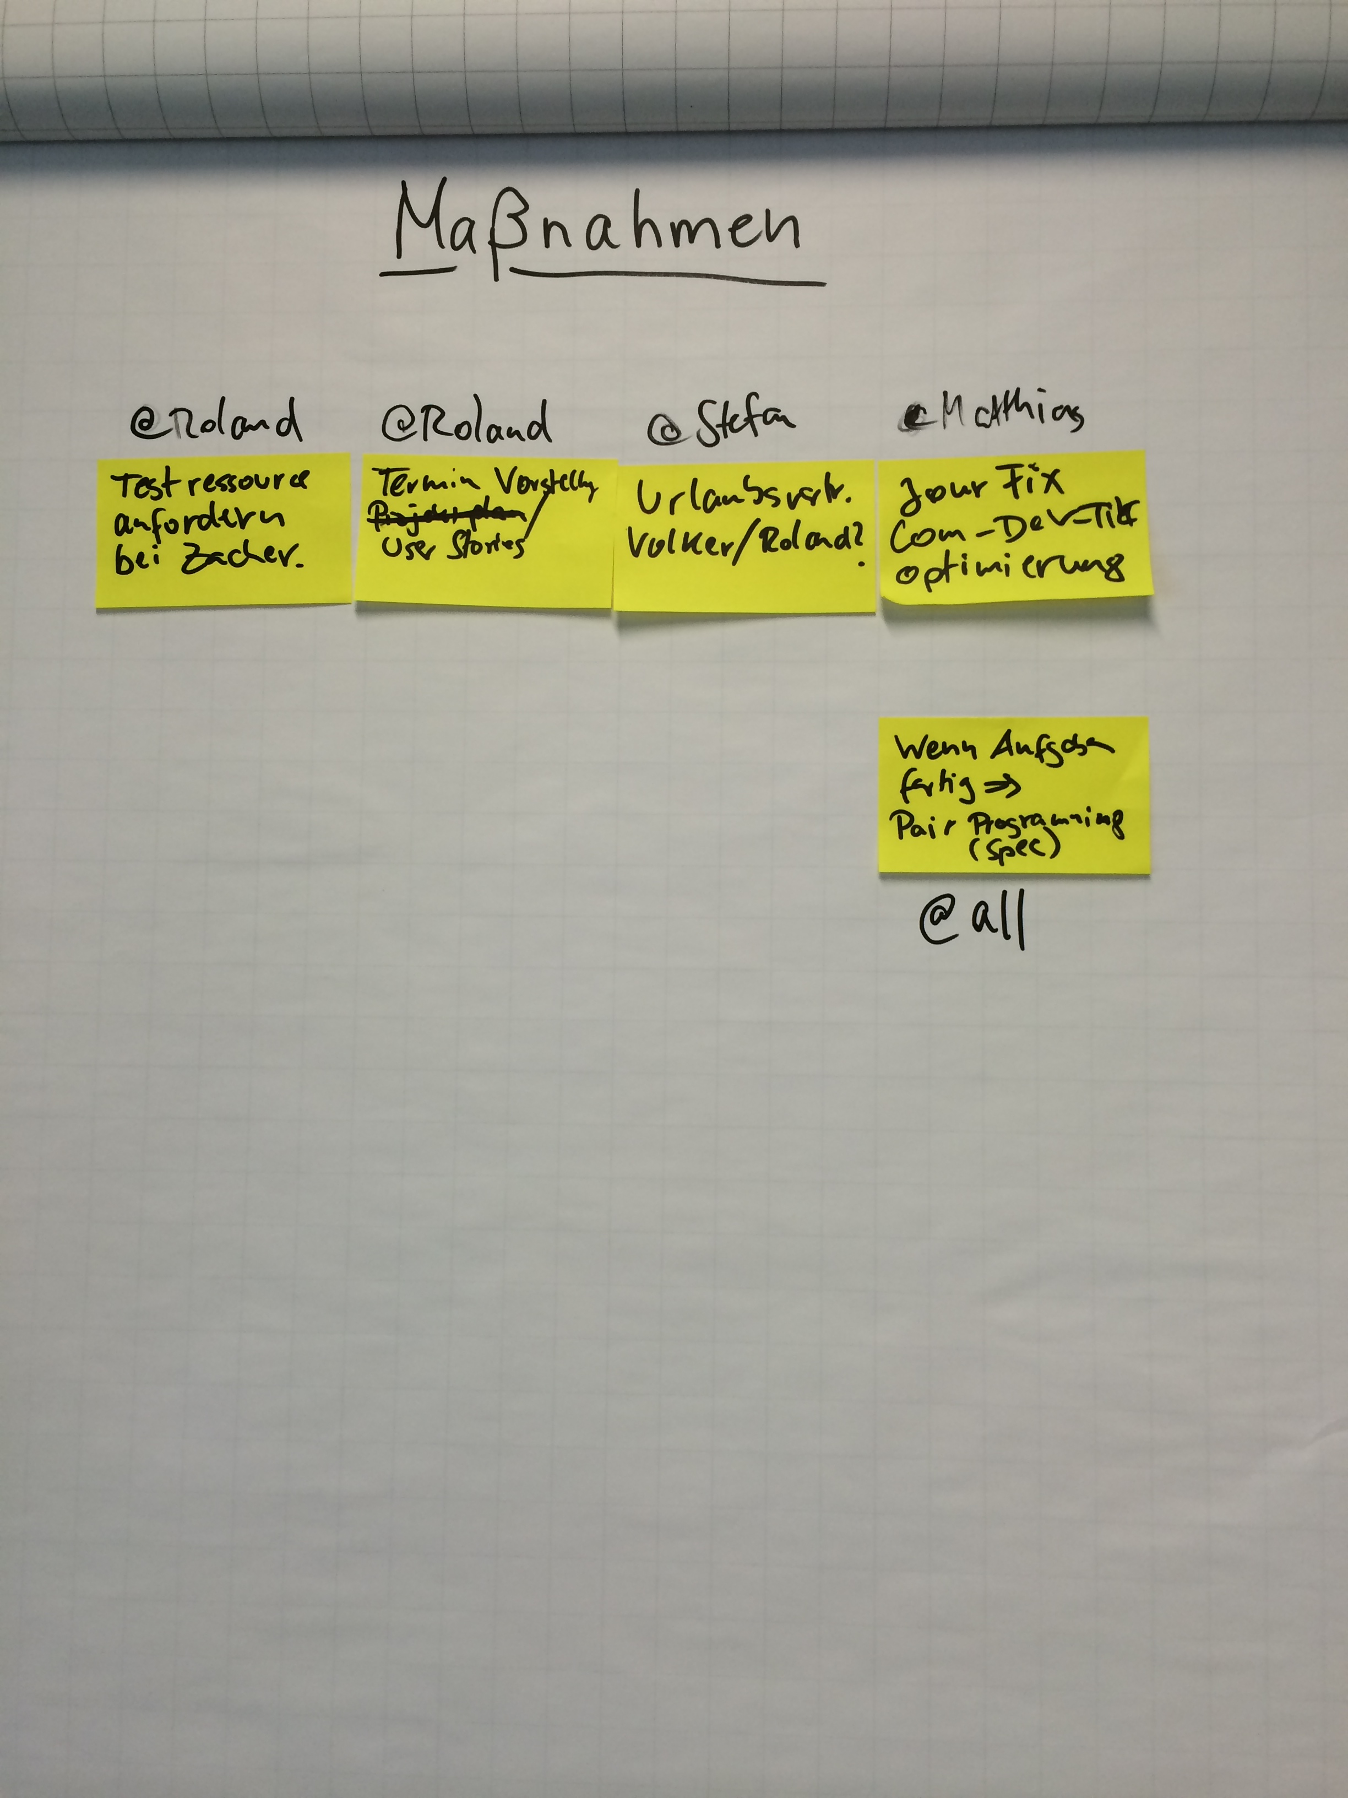

Slide 35
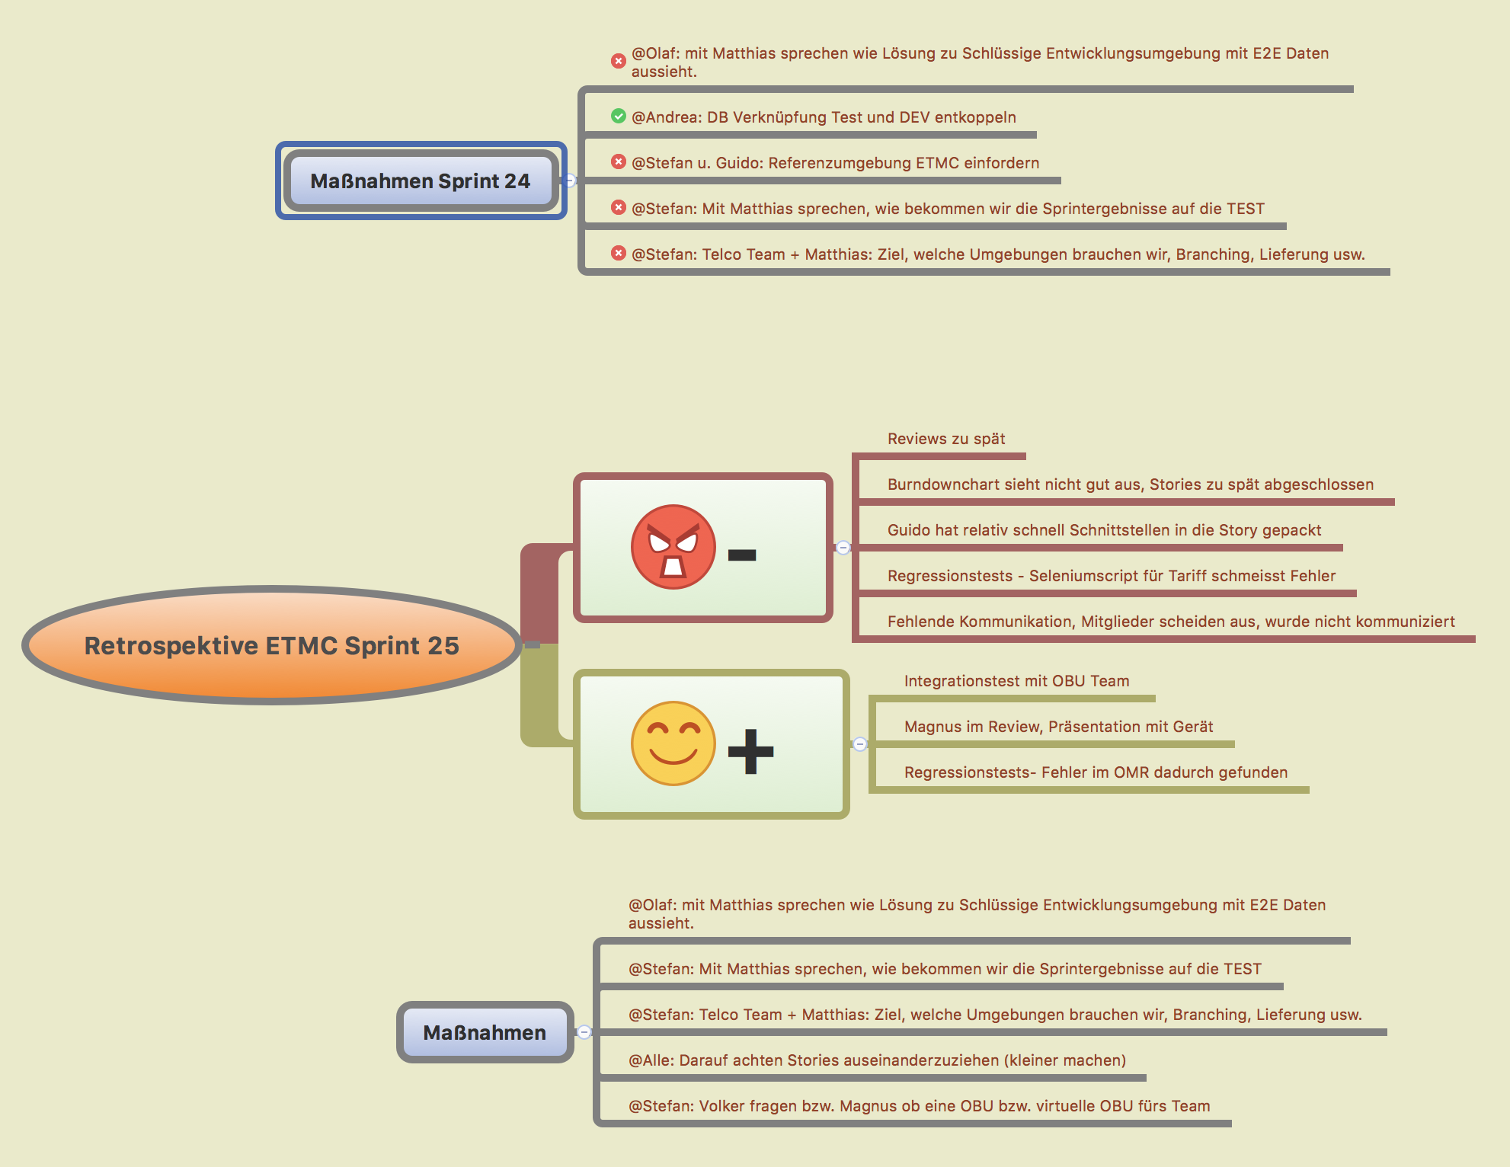
Sprint Retrospective

Slide 36
The Roles
Notes:
Planning: 1w / 2h, 2w / 4h… max 8h
Review: 1h for 1 week sprint → 1w / 1h, 2w, 2h… max 4h
Retrospective: 45m for 1 week sprint → 1w / 45m, 2w / 1,5h... Max 3h

Slide 37
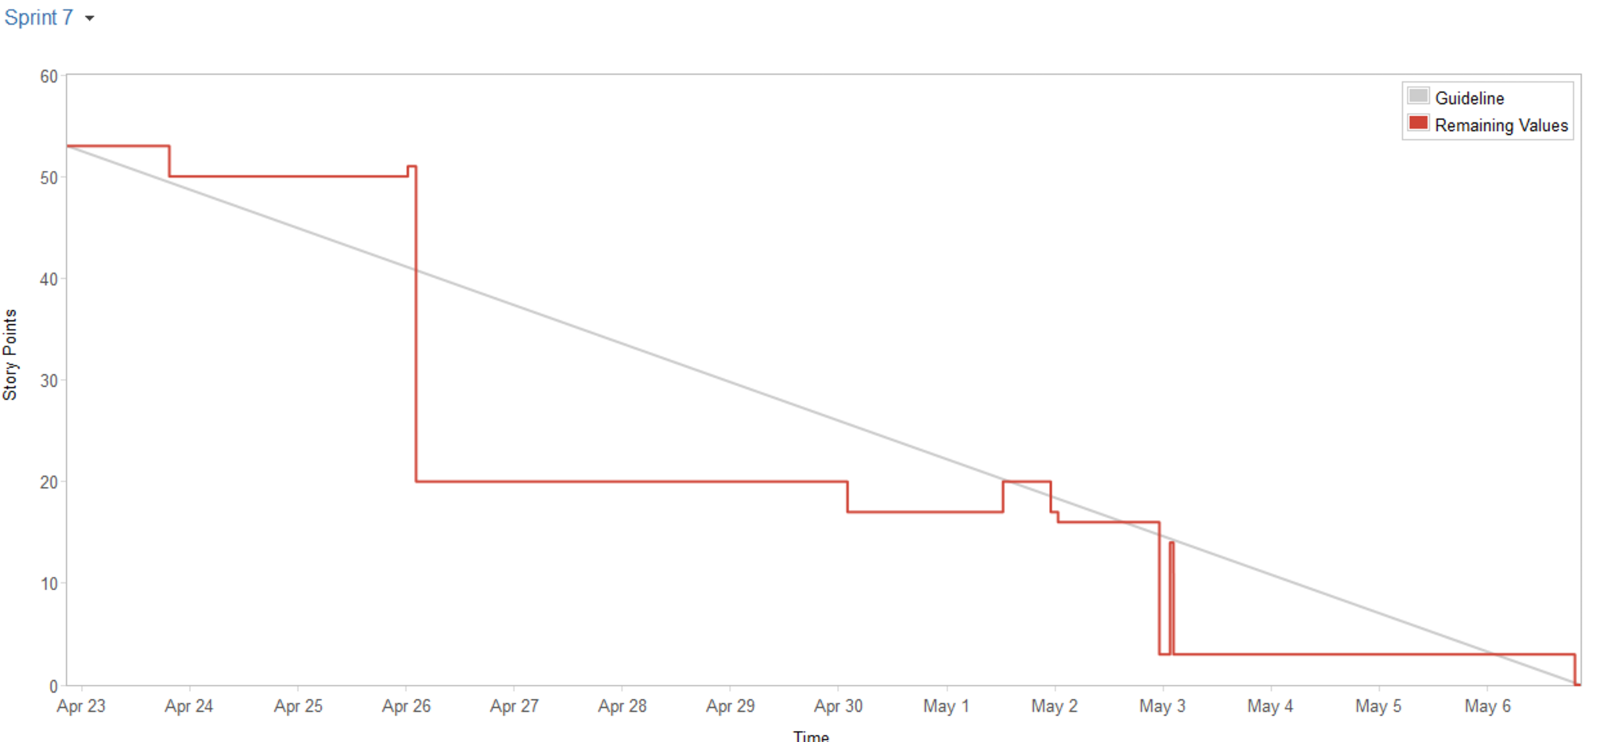
Burndown chart

Slide 38
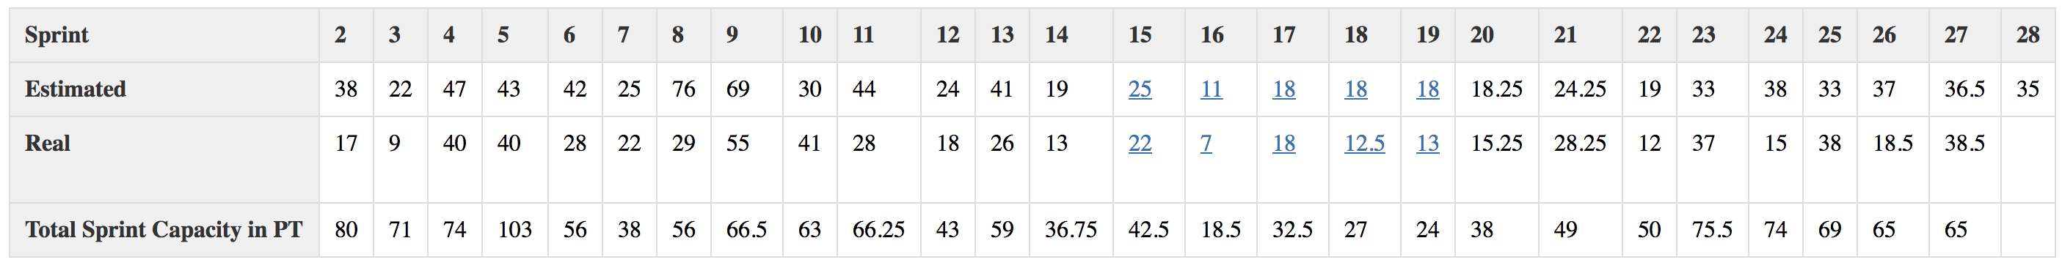
How to estimate?
How much can we do in the next sprint?
Check what was done in the last sprints
Velocity is Storypoints DONE in the last sprint(s)
Average Velocity: 25 SP

Slide 39
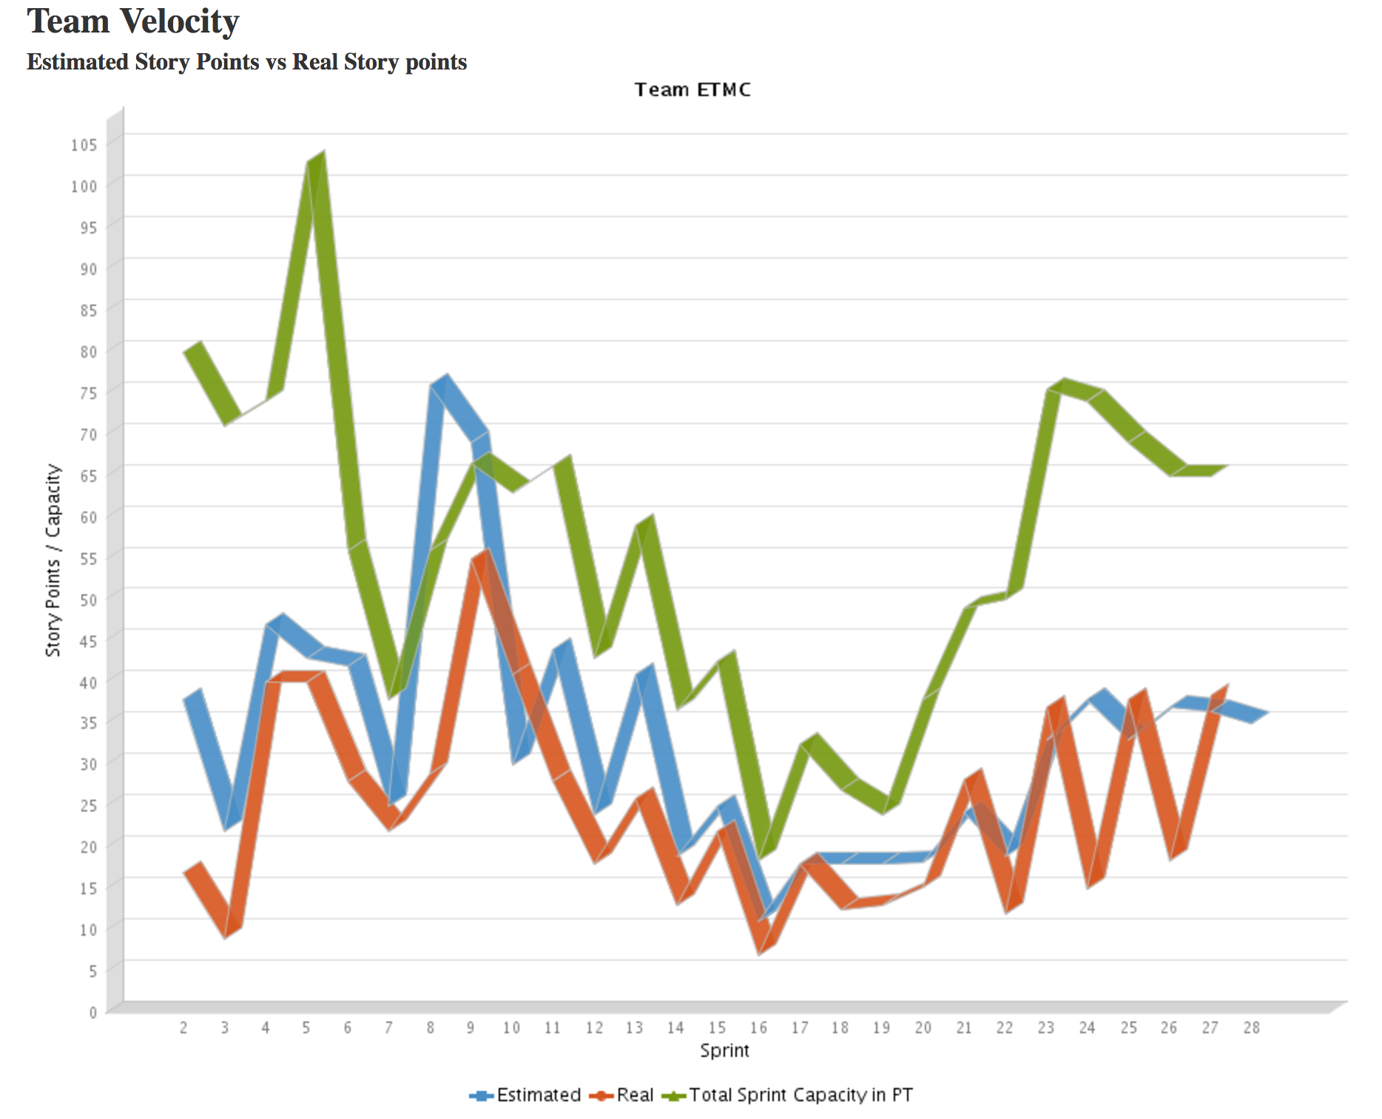
How to estimate?

Slide 40

How to start?

Slide 41
Schedule
Week 7 (CW 43)
Scrum Intro / Rerun (Friday)
Getting familiar with the case
Project Week (CW 44)
Getting familiar with the case
Create first draft SRS
Create first draft high level design
Deliverable: SRS-draft in groups repository
Week 8 (CW 45) – 1st Sprint
Monday: Planning Meeting
Friday: Review Meeting (Demo)
Week 9 (CW 46) – 2nd Sprint
Monday: Planning Meeting
Friday: Review Meeting (Demo)
Week 10 (CW 47) – 3rd Sprint
Monday: Planning Meeting
Friday: Review Meeting (Demo)
Week 11 (CW 48) – 4th Sprint
Monday: Planning Meeting
Friday: Review Meeting (Demo)
Week 12 (CW 49) – 5th Sprint
Monday: Planning Meeting
Friday: Review Meeting (Demo)
Week 13 (CW 50) – 6th Sprint
Monday: Planning Meeting
Friday: Review Meeting (Demo)
Week 14 (CW 51) – Assessments
Individual Assessments

Slide 42
What to do today and in the project week?
Setup you scrum process and your project
Check the Scrum roles and decide who should take the role(s)
How and where do we manage our work items (Use Cases, User Stories, Epics, Features, Ideas...)
In a backlog?
Trello? Github project kanban? Github ZenHub? Jira?
When, where and how will you hold your daily?

Slide 43
What to do today and in the project week?
Start with a high level SRS
Why?
You need to deliver one end of project week ☺
But more important, you need to have an idea about the high level functionalities and architecture
because you need to fill your backlog!!! (items, stories, epics, features... you want to work on)

Slide 44
Scrum Board
You are free to choose your tool
Trello
Github Project
Jira
…

Slide 45
Backup slides / additional information

Slide 46
Issues when using scrum
Product Owner has no or not much time
Not having a Scrum Master
Not doing the Retrospective
Long Dailies
Distributed Teams have impact on performance

Slide 47
Scrum taken serious
https://www.youtube.com/watch?v=P6v-I9VvTq4&list=PL149018B659B36F9A&index=1

Slide 48




Books
Agile Product Management with Scrum (Pichler
Scrum - Agiles Projektmanagement erfolgreich einsetzen (Pichler)
Agile Coaching (Davis /Sedley)
Agile Retrospectives: Making Good Teams Great (Derby / Larson)

